Slide 1
Database Systems and Applications

Slide 2
Contact Session 9: Normalization (3NF & BCNF)

Slide 3
Example 1
Consider the given the following data file: [8M]
EMPLOYEE (ENAME, ENO, EADDRESS, EDESIGNATION, SAL, ... )
record size R = 120 bytes, block size B = 512 bytes AND r = 80000 records
For an index on the SSN field, assume the field size V_{SSN}=10 bytes and the record pointer size P_{R}=6 bytes.
And let’s see how to find the following
blocking factor Bfr
number of file blocks
index entry size
index blocking factor
number of index blocks

Slide 4
Example 1(cont.)
Sol:- Given
Record size bytes, R = 12 bytes
Block size bytes, B = 512 bytes
Number of records, r = 80,000
SSN field size bytes, Vssn = 10 bytes
Record pointer size bytes, Pr = 6 bytes
a) Bf = B/R
Bf = 512/120 = 4 records per block
b) File blocks = r/Bf
File blocks = 80000/4 = 20,000 blocks

Slide 5
Example 1(cont.)
c) Index entry size = Vssn + Pr
Index entry size = 10 + 6 = 16 bytes
d) Bf^index = N/Index entry size
Bf^index = 512/16 = 32 entries per block
e) Index blocks = r/ Bf^index
Index blocks = 80000/32 = 2,500 blocks

Slide 6
Example
Consider the following relational database: [12M]
DOCTOR (Doctor-no, Doctor-name, Address, City)
HOSPITAL (Hospital-no, Name, Street, City)
DOC-HOSP (Doctor-no, Hospital-no, Date)
Construct the following queries in SQL:

Slide 7
Commands
a) Find out all doctors who have visited hospitals in the same city they live in, in descending order of their names.
SELECT DISTINCT D.Doctor-name
FROM DOCTOR D
JOIN DOC-HOSP DH ON D.Doctor-no = DH.Doctor-no
JOIN HOSPITAL H ON DH.Hospital-no = H.Hospital-no
WHERE D.City = H.City
ORDER BY D.Doctor-name DESC;

Slide 8
cont.
b) Find out to which hospitals "Dr. Smith" has visited.
SELECT H.Name AS Hospital_name
FROM DOCTOR D
JOIN DOC-HOSP DH ON D.Doctor-no = DH.Doctor-no
JOIN HOSPITAL H ON DH.Hospital-no = H.Hospital-no
WHERE D.Doctor-name = 'Dr. Smith';

Slide 9
Cont.
c) Count the number of doctors who visited "Shree Clinic" on 1 March 1999.
SELECT COUNT(DISTINCT DH.Doctor-no) AS Number_of_Doctors
FROM DOC-HOSP DH
JOIN HOSPITAL H ON DH.Hospital-no = H.Hospital-no
WHERE H.Name = 'Shree Clinic' AND DH.Date = '1999-03-01’;
d) Find out how many times "Dr. Joshi" has visited "Shree Clinic."
SELECT COUNT(*) AS Number_of_Visits
FROM DOC-HOSP DH
JOIN DOCTOR D ON DH.Doctor-no = D.Doctor-no
JOIN HOSPITAL H ON DH.Hospital-no = H.Hospital-no
WHERE D.Doctor-name = 'Dr. Joshi' AND H.Name = 'Shree Clinic';

Slide 10
Agenda
3NF – Third Normal Form
General Definitions and Examples
BCNF – Boyce-Codd Normal Form
General Definition and Examples
Properties of Relational Decompositions
Dependency Preservation property
Nonadditive (Lossless) Join property (testing)
Algorithms for Relational Database Schema Design
Dependency preserving and Nonadditive (Lossless) Join decomposition into 3NF and BCNF
Examples for 3NF and BCNF

Slide 11
3NF (Third Normal Form)
General Definition of 3NF
A given relation R is in 3NF, if for every FD X → Y in F⁺,
(i) Y ⊆ X (trivial); or
(ii) each attribute A in Y-X is contained in CK of R i.e. it is prime; or
(iii) X is a super key.

Slide 12
3NF (Third Normal Form) – Example 1
Consider R = {S, A, I, P} and F = {SI → P, S → A}
Using Algorithm 15.2(a) (see next slide)
CK = SI (the only candidate key) and A is nonprime
The FD SI → P doesn’t violate 3NF definition.
The FD, S → A violates 3NF definition, because S is not a superkey.
So, R in NOT in 3NF
In fact, S → A is a partial dependency (S is a subset of the key)
Decomposed 3NF relations (remove A from R):
R1(S, I, P) with F = {SI → P} in 3NF
R2(S, A) with F = {S → A} in 3NF

Slide 13
Finding Candidate Keys (Algorithm 9.1)
Algorithm 9.1. Finding a Key K for R Given a set F of Functional Dependencies
Input: A relation R and a set of functional dependencies F on the attributes of R.
1. Set K := R.
2. For each attribute A in K
{
compute (K – A)⁺ with respect to F;
if (K – A)⁺ contains all the attributes in R,
then set K := K – {A}
};

Slide 14
Finding Candidate Keys (Algorithm 9.2)
Algorithm CandidateKey(R, F)
1. LS ← φ; RS ← φ; BS ← φ; CK ← φ // CK – Candidate key
2. For each FD do:
LS ← LS ∪ all attributes appearing only in LHS
RS ← RS ∪ all attributes appearing only in RHS
BS ← BS ∪ all attributes appearing on both the sides
3. If LS = φ and RS = φ Then
use the algorithm of [3] – exhaustive method
4. If LS⁺ = R then
CK ← CK ∪ LS
Return CK.
5. For each attribute A ∈ BS do:
LS ← LS ∪ A
If LS⁺ = R Then CK ← CK ∪ LS
LS ← LS – A
6. Return CK.

Slide 15
Exercise 1
Consider R (A, B, C, G, H, I), and F = {A → BC, CG → HI, B → H}.
Find all Candidate keys of R.
Solution:
Using Algorithm 9.2,
LS = {A, G}; RS = {H, I}; BS = {B, C}
AG⁺ = {AG}
AG⁺ = {AGBC} because of FD1
AG⁺ = {AGBCHI} because of FD2
Since AG determines all the attributes of R, hence this is the only CK.

Slide 16
Exercise 2
Consider R(A, B, C, D, E, H), and F = {A → B, AB → E, BH → C, C → D, D → A}
Find all Candidate keys of R.
Solution:
Using Algorithm 9.2,
LS = {H}; RS = {E}; BS = {A, B, C, D}
H⁺ = {H}
H⁺ = {H} no change, so pick A from “BS” set
HA⁺ = {HABECD}
Since HA determines all the attributes of R, hence this is a CK.
Similarly, HB, HC, HD are candidate keys.

Slide 17
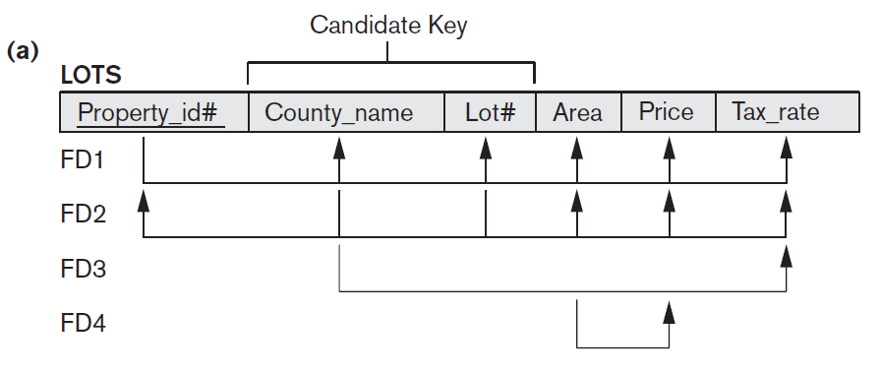
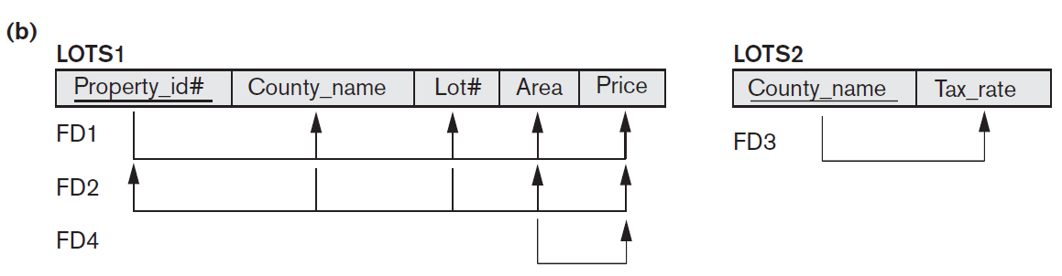
3NF (Third Normal Form) – Example 2
Consider the relation LOTS
LOTS1 not in 3NF, but LOT2 in 3NF
FD4 in LOTS1 violates 3NF because Area is not a superkey and Price is not a prime attribute in LOTS1.

Slide 18
Example 2 (Contd.)
LOTS1 not in 3NF, but LOT2 in 3NF
FD1 = {Property_id# → County_name, Lot#, Area, Price}
FD2 = {County_name, Lot# → Property_id#, Area, Price}
FD4 = {Area → Price}
CKs = {Property_id#} and {Lot#, County_name}
FD1 & FD2 – no violation
But, FD4 violates the definition, because Area is not a superkey and
Price is not a prime attribute in LOTS1.
Area – acts as transitive dependency attribute.

Slide 19
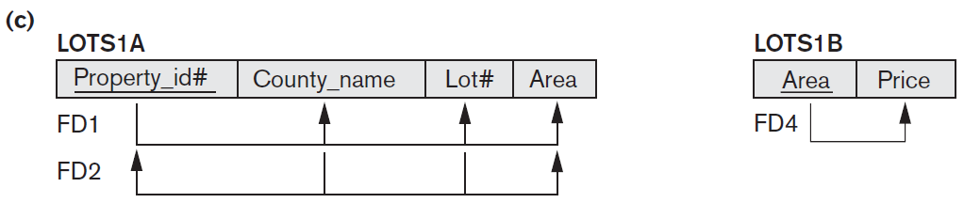
Example 2 (Contd.)
To normalize LOTS1 into 3NF, we decompose it into the relation schemas LOTS1A and LOTS1B.
LOTS1A – remove the attribute Price that violates 3NF from LOTS1
Place it with Area (the left hand side of FD4 that causes the transitive dependency) into another relation LOTS1B. Both LOTS1A and LOTS1B are in 3NF.
LOTS1A = [{Property_id# → County_name, Lot#, Area},
{County_name, Lot# → Property_id#, Area}]
LOTS1B = {Area → Price}

Slide 20
Interpreting the General Definition
of Third Normal Form
A relation schema R violates the general definition of 3NF if a functional dependency X → Y holds in R that does not meet all three conditions. This can occur due to two types of problematic functional dependencies:
A nonprime attribute determines another nonprime attribute. Here we typically have a transitive dependency that violates 3NF.
A proper subset of a key of R functionally determines a nonprime attribute. Here we have a partial dependency that violates 3NF (and also 2NF).
General alternative definition of 3NF
A relation schema R is in 3NF if every nonprime attribute of R meets both of the following conditions:
It is fully functionally dependent on every key of R.
It is nontransitively dependent on every key of R.

Slide 21
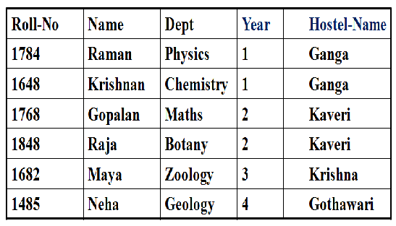

Slide 22
Ans 1
The given table is 3NF.
There are no transitive dependencies.
For example :-
Hostel-Name does not depend on Dept, Name, or Year – it only depends on Roll-No.
Every non-key attribute is directly dependent on the primary key.

Slide 23
Name
Roll No
Dept.
Year
Hostel_Name

Slide 24
The dependency diagram shows a one-to-many relationship.
In a one-to-many relationship, one entity (in this case, "Roll No") can be associated with multiple entities of another type (in this case, "Name", "Dept.", "Year", and "Hostel Name").
Here's how it works in the given diagram:
* A single "Roll No" can be associated with multiple pieces of information: a "Name", a "Dept.", a "Year", and a "Hostel Name".
* However, a single "Name", "Dept.", "Year", or "Hostel Name" can only be associated with one "Roll No".
This type of relationship is common in databases where you want to store multiple details about a single entity.

Slide 25
Let’s say we want to promote a normal form to BCNF. Below is a examples:-
The next level after Third Normal Form (3NF) is the Boyce-Codd Normal Form (BCNF), which is a stricter version of 3NF. To promote a 3NF table to BCNF, you must ensure the following condition:
BCNF Condition:
Every determinant (attribute or set of attributes that determines other attributes) in the table must be a candidate key.
Example of Promotion to BCNF:
Let’s assume a scenario where the given table has an additional dependency:
Functional Dependency:
Dept → Hostel-Name
This means the Hostel-Name is determined by the Dept and not directly by the Roll-No.

Slide 26
Issue:
Here, Dept is a determinant but not a candidate key (since Roll-No is the primary key). This violates BCNF.
Solution:
Decompose the table as follows:
1. Table 1: Keep the primary key (Roll-No) and remove the dependency.
Roll-No | Name | Dept | Year
1784 | Raman | Physics | 1
1648 | Krishnan | Chemistry | 1

Slide 27
2. Table 2: Separate the dependency (Dept → Hostel-Name) into a new table.
After decomposition, the resulting tables are in BCNF. Each determinant is now a candidate key, satisfying the stricter BCNF rules.
Dept | Hostel-Name
Physics | Ganga
Chemistry | Ganga

Slide 28
Boyce-Codd Normal Form (BCNF)
Every relation in BCNF is also in 3NF; however, a relation in 3NF is not necessarily in BCNF.
BCNF is simpler form of 3NF, but stronger than 3NF.
Definition: A relation R is in BCNF if for every FD X → Y in F⁺,
(i) Y ⊆ X (trivial); or
(ii) X is a superkey
Note that the second condition in 3NF definition is missing here,; thus making BCNF stronger.

Slide 29
3NF versus BCNF
A relation is in 3NF if it is in 2NF and there are no transitive dependencies.
What about a case in which a non-key attribute is the determinant of a key attribute?
This condition does not violate 3NF, but does violate BCNF. Because, BCNF expects that every determinant in the relation be a candidate key.
Example:
AB → CD C → B
A | B | C | D

Slide 30
3NF versus BCNF (contd.)
Example:
How to decompose this table and make it BCNF?
Decompose Rule (Ullman):
If the violating FD is: X → A, then
D = {R – A} and {XA}
R(A, B, C, D), F = {AB → CD, C → B}
CK = {AB} and D = {ACD, CB}
AB → CD C → B
A | B | C | D

Slide 31
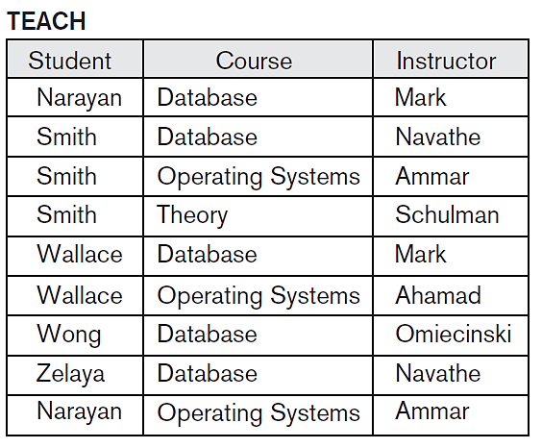
Decomposition of Relations not in BCNF
Example
FD1: {Student, Course} → Instructor
FD2: Instructor → Course each instructor teaches only one course
CK = {Student, Course} as per Algorithm 9.2
Possible BCNF decompositions
{Student, Instructor} and {Student, Course}.
{Course, Instructor} and {Course, Student}.
{Instructor, Course} and {Instructor, Student}.
All three decompositions lose the functional dependency FD1.
The desirable properties are: nonadditive (lossless and FD preservation)
So 3rd decomposition satisfies both the properties.

Slide 32
Nonadditive (lossless) Join Test for Binary Decomposition
As per the following theorem of Ullman
Theorem: Let F be a set of FDs over R, and D = {R1, R2} be a decomposition of R. D is a lossless-join decomposition if and only if
R1 ∩ R2 → R1 - R2 is in F⁺ or
R1 ∩ R2 → R2 - R1 is in F⁺
Example
Consider R(ABC), F = {A → B}
Decompose R into AB and AC. AB ∩ AC = A and AB – AC = B
So, A → B holds. This means the decomposition is lossless.
However, if we decompose R into AB and BC, then
AB ∩ BC = B and AB – BC = A or BC – AB = C
This means that the decomposition is lossy!

Slide 33
Nonadditive (lossless) Join Test for Binary Decomposition (Contd.)
Example
Consider R (City, Street, Zipcode) or R (C, S, Z) and F = {CS → Z, Z → C}.
CK1 = {CS} and CK2 = {ZS} (using Algorithm 5.2(a))
The relation R is in 3NF (since each attribute is prime) but not in BCNF, because in Z → C, Z is not a superkey and also it is not a trivial FD. In R, we cannot store the city to which a zipcode belongs unless we know a street address with the zipcode. This introduces insertion anomaly.
To convert this into BCNF, decompose R into: R1 = {Z, C} and R2 = {S, Z}
Any relation schema with exactly two attributes is in BCNF.

Slide 34
BCNF Checking
For each functional dependency X → Y in R calculate X⁺.
If X⁺ includes all the attributes of R, then it is in BCNF, otherwise it is not.

Slide 35
BCNF Checking - Example 1
Consider R (City, Street, Zipcode) or R (C, S, Z) and
F = {CS → Z, Z → C}.
Attribute Closure
(CS)⁺ = (C, S, Z) and Z⁺ = (Z, C).
The second FD does not include all attributes and hence R is not in BCNF.

Slide 36
BCNF Checking - Example 2
FD1: {Student, Course} → Instructor and
FD2: Instructor → Course
(Student, Course)⁺ = (Student, Course, Instructor)
(Instructor)⁺ → (Instructor, Course)
Since FD2 doesn’t include all attributes, it is not in BCNF.

Slide 37
Properties of Relational Decompositions
Relation Decomposition and Insufficiency of Normal Forms
Dependency Preservation Property of a Decomposition
Non-additive (Lossless) Join Property of a Decomposition

Slide 38
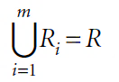
(a) Relation Decomposition and Insufficiency of Normal Forms
The set F of functional dependencies that should hold on the attributes of R is specified by the database designers and is made available to the design algorithms.
Using the functional dependencies, the algorithms decompose the universal relation schema R into a set of relation schemas D = {R₁, R₂, ..., R_{m}} that will become the relational database schema; D is called a decomposition of R.
We must make sure that each attribute in R will appear in at least one relation schema R_{i} in the decomposition so that no attributes are lost; formally, we have
This is called the attribute preservation condition of a decomposition.

Slide 39
(b) Dependency Preservation Property of a Decomposition
Dependency preservation condition - each functional dependency X→Y specified in F either appeared directly in one of the relation schemas R_{i} in the decomposition D or could be inferred from the dependencies that appear in some R_{i}.
Why should we need to preserve the FD? - each dependency in F represents a constraint on the database.
Definition: We say that a decomposition D = {R₁, R₂, ..., R_{m}} of R is dependency-preserving with respect to F if the union of the projections of F on each R_{i} in D is equivalent to F; that is, ((πR₁(F)) ∪ ... ∪ (πR_{m}(F)))⁺ = F⁺.

Slide 40
Projecting a set of FDs onto a Subset of the Attributes (Example-1)
Suppose we have R(ABCDE) with these F = {A → C, C → E, E → BD}
Project the FDs onto attributes ABC.
Solution
To project onto a set of attributes, we systematically consider every possible LHS of an FD that might hold on those attributes.
A⁺ = ACEBD, therefore A → BC. (It also functionally determines DE, but these are not in our set of attributes.)
B⁺ = B. This yields no FDs for our set of attributes.
C⁺ = CEBD, therefore C → B.
We don't need to consider any supersets of A. A already determines all of our attributes ABC, so supersets of A will only yield FDs that already follow from A → BC.
The only remaining subset of the attributes ABC to consider is BC. BC⁺ = BCED. This yields no FDs for our set of attributes.
So the projection of the FDs onto ABC is: {A → BC, C → B}

Slide 41
Testing Dependency Preservation of Decomposition (Example-2)
Consider R(CSZ) and F = {CS → Z, Z → C}
Assume D = {R1(SZ), R2(CZ)}. Does this decomposition preserve the dependencies?
Solution
F1 = ∏_{SZ}(F) = No non-trivial FDs
F2 = ∏_{CZ}(F) = Z → C
F ≠ F1 ∪ F2
Since this decomposition does not imply CS → Z, we conclude that there is no dependency preservation.

Slide 42
Example-3
Consider the relation Booking(Title, Theater, City) with FDs
F = {Theater → City, Title, City → Theater}
CK1 = {Title, Theater} and CK2 = {Title, City} using Algorithm 9.2
This relation is not in BCNF, because of violating FD Theater → City
Hence, the decomposed relations:
D = {Booking1(Title, Theater), Booking2(Theater, City)}
Does it preserve the FDs?
NO!
F1: No FDs
F2: {Theater →City}
F ≠ F1 ∪ F2

Slide 43
(c) Nonadditive (Lossless) Join Property of a Decomposition
No spurious tuples are generated when a NATURAL JOIN operation is applied to the relations resulting from the decomposition, D.
Definition: Formally, a decomposition D = {R₁, R₂, ..., R_{m}} of R has the lossless (nonadditive) join property with respect to the set of dependencies F on R if, for every relation state r of R that satisfies F, the following holds, where * is the NATURAL JOIN of all the relations in D: *(πR₁(r), ..., πR_{m}(r)) = r.
The nonadditive join property ensures that no spurious tuples result after the application of PROJECT and JOIN operations.

Slide 44
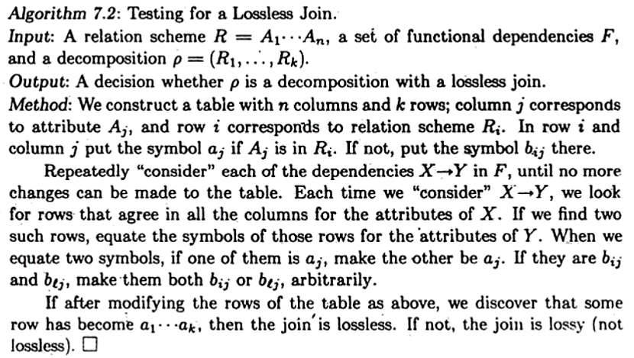
Testing for Nonadditive (Lossless) Join Property

Slide 45
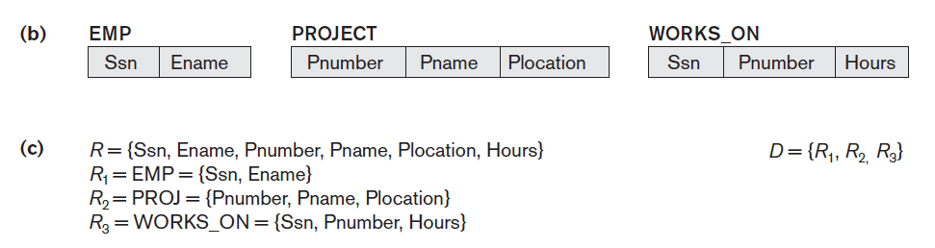
Example-1
Consider the following relation and its decomposition:
F = {Ssn → Ename; Pnumber → {Pname, Plocation}; {Ssn, Pnumber} → Hours}
Initial Table (R₁ has Ssn and Ename and so use “a” symbols, and so on.)
 | Ssn | Ename | Pnumber | Pname | Plocation | Hours
R₁ | a1 | a2 | b13 | b14 | b15 | b16
R₂ | b21 | b22 | a3 | a4 | a5 | b26
R₃ | a1 | b32 | a3 | b34 | b35 | a6

Slide 46
Example-1 (Contd.)
After applying FD: Ssn → Ename
Equate R₁ and R₃
 | Ssn | Ename | Pnumber | Pname | Plocation | Hours
R₁ | a1 | a2 | b13 | b14 | b15 | b16
R₂ | b21 | b22 | a3 | a4 | a5 | b26
R₃ | a1 | b32 a2 | a3 | b34 | b35 | a6

Slide 47
Example-1 (Contd.)
After applying FD: Pnumber → {Pname, Plocation}
Pnumber → Pname and Pnumber → Plocation
Equate R₂ and R₃ then R₂ and R₃
 | Ssn | Ename | Pnumber | Pname | Plocation | Hours
R₁ | a1 | a2 | b13 | b14 | b15 | b16
R₂ | b21 | b22 | a3 | a4 | a5 | b26
R₃ | a1 | b32 a2 | a3 | b34 a4 | b35 | a6
 | Ssn | Ename | Pnumber | Pname | Plocation | Hours
R₁ | a1 | a2 | b13 | b14 | b15 | b16
R₂ | b21 | b22 | a3 | a4 | a5 | b26
R₃ | a1 | b32 a2 | a3 | b34 a4 | b35 a5 | a6
last row is all “a” symbols so we stop and it’s lossless.

Slide 48
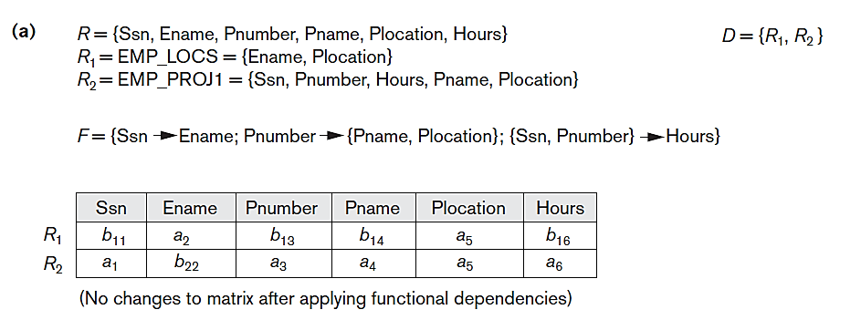
Example-2
No row has all “a” symbols. Hence, it’s lossy.

Slide 49
Example-3
Consider R(A, B, C, D, E)
F = {A → C, B → C, C → D, DE → C, CE → A}
R1(AD), R2(AB), R3(BE), R4(CDE), R5(AE)
 | A | B | C | D | E
R1 | a1 | b12 | b13 | a4 | b15
R2 | a1 | a2 | b23 | b24 | b25
R3 | b31 | a2 | b33 | b34 | a5
R4 | b41 | b42 | a3 | a4 | a5
R5 | a1 | b52 | b53 | b54 | a5

Slide 50
Example-3 : FD1
R(A, B, C, D, E)
FD = A → C
Rows 1, 2, 5 will need to change the values for the RHS attribute C – equate b13, b23, b53 to b13 (you might very well have picked b23 or b53 to equate all three).
We won’t change the rows 3 & 4 yet because their symbols b31, b41 are different from a1.
 | A | B | C | D | E
R1 | a1 | b12 | b13 b13 | a4 | b15
R2 | a1 | a2 | b23 b13 | b24 | b25
R3 | b31 | a2 | b33 | b34 | a5
R4 | b41 | b42 | a3 | a4 | a5
R5 | a1 | b52 | b53 b13 | b54 | a5

Slide 51
Example-3 : FD2
R(A, B, C, D, E)
FD = B → C
Consider rows 2 and 3 only. Equate b33 with b13
 | A | B | C | D | E
R1 | a1 | b12 | b13 b13 | a4 | b15
R2 | a1 | a2 | b23 b13 | b24 | b25
R3 | b31 | a2 | b33 b13 | b34 | a5
R4 | b41 | b42 | a3 | a4 | a5
R5 | a1 | b52 | b53 b13 | b54 | a5

Slide 52
Example-3 : FD3
R(A, B, C, D, E)
FD = C → D
 | A | B | C | D | E
R1 | a1 | b12 | b13 b13 | a4 | b15
R2 | a1 | a2 | b23 b13 | b24 a4 | b25
R3 | b31 | a2 | b33 b13 | b34 a4 | a5
R4 | b41 | b42 | a3 | a4 | a5
R5 | a1 | b52 | b53 b13 | b54 a4 | a5

Slide 53
Example-3 : FD4
R(A, B, C, D, E)
FD = DE → C
Equate b13 (all occurrences) with a3
 | A | B | C | D | E
R1 | a1 | b12 | b13 b13 a3 | a4 | b15
R2 | a1 | a2 | b23 b13 a3 | b24 a4 | b25
R3 | b31 | a2 | b33 b13 a3 | b34 a4 | a5
R4 | b41 | b42 | a3 | a4 | a5
R5 | a1 | b52 | b53 b13 a3 | b54 a4 | a5

Slide 54
Example-3 : FD5
R(A, B, C, D, E)
FD = CE → A
Equate b31, b41, and a1.
 | A | B | C | D | E
R1 | a1 | b12 | b13 b13 a3 | a4 | b15
R2 | a1 | a2 | b23 b13 a3 | b24 a4 | b25
R3 | b31 a1 | a2 | b33 b13 a3 | b34 a4 | a5
R4 | b41 a1 | b42 | a3 | a4 | a5
R5 | a1 | b52 | b53 b13 a3 | b54 a4 | a5
It is Lossless, because Row 3 has all “a” symbols.

Slide 55
Algorithms for Relational Database
Schema Design
Dependency-Preserving and Nonadditive Join Decomposition into 3NF Schemas
It is not possible to have all three of the following:
Guaranteed non-lossy design (it is a must)
Guaranteed dependency preservation (desirable)
All relations in BCNF (not mandatory)

Slide 56
Algorithm for 3NF
Algorithm 3NF_Relations(R, F)
// Relational synthesis into 3NF with dependency preservation and
// Nonadditive Join Property
Step-1: G = Call MinimalCover (F).
Step-2: For each left-hand-side X of a functional dependency that appears in G, create a relation schema in D with attributes {X ∪ {A₁} ∪ {A2} ... ∪ {A_{k}} }, where X→A₁, X→A₂, ..., X→A_{k} are the only dependencies in G with X as the left-hand- side (X is the key of this relation)
Step-3: If no relation in D contains a key for R, then create a new relation schema that contains attributes to form a key for R.
Step-4: Eliminate redundant relations from the resulting set of relations in the relational database schema. A relation R is considered redundant if R is a projection of another relation S in the schema; alternately, R is subsumed (include or contain) by S.

Slide 57
Example-1
Consider EMPPROJ(Emp_ssn, Pno, Esal, Ephone, Dno, Pname, Plocation)
FD1: Emp_ssn → {Esal, Ephone, Dno}
FD2: Pno → { Pname, Plocation}
FD3: Emp_ssn, Pno → {Esal, Ephone, Dno, Pname, Plocation}
The CK of EMPPROJ is {Emp_ssn, Pno}
Step-1 [Call MinimalCover()] :
F = { Emp_ssn → Esal
Emp_ssn → Ephone
Emp_ssn → Dno
Pno → Pname,
Pno → Plocation
{Emp_ssn, Pno} → Esal
{Emp_ssn, Pno} → Ephone
{Emp_ssn, Pno} → Dno
{Emp_ssn, Pno} → Pname
{Emp_ssn, Pno} → Plocation }.

Slide 58
Example-1 (Contd.)
Step-1: All FDs in F have single attributes on RHS.
Check for redundant attributes on LHS.
{Emp_ssn, Pno} → Esal Pno is redundant
{Emp_ssn, Pno} → Ephone Pno is redundant
{Emp_ssn, Pno} → Dno Pno is redundant
{Emp_ssn, Pno} → Pname Emp_ssn is redundant
{Emp_ssn, Pno} → Plocation Emp_ssn is redundant
Hence, all these FDs are redundant.
So, G = {Emp_ssn → Esal
Emp_ssn → Ephone
Emp_ssn → Dno
Pno → Pname
Pno → Plocation}

Slide 59
Example-1 (Contd.)
Step-2: D = { R1(Emp_ssn, Esal, Ephone, Dno)
R2(Pno, Pname, Plocation) }
Step-3: D does not have the key of EMPPROJ. So, we need to create a third relation.
D = { R1(Emp_ssn, Esal, Ephone, Dno)
R2(Pno, Pname, Plocation)
R3(Emp_ssn, Pno }
Step-4: None of the above relations is redundant. Hence, D is unaltered.

Slide 60
Example-2
Given a relation R(A, B, C, D, E, F, G) and F = {AB → C, A → D, BD → C, D → BG, AE → F}
Finding Minimal cover of F is as follows:
Step-1: G = F
Step 2: G = {AB → C, A → D, BD → C, D → B, D → G, AE → F}
Step 3: The only FDs to be considered are
AB → C, BD → C, AE → F.
For AB → C, we want to find whether A → C or B → C holds or not.
Because A → D, D → B implies A → B (transitivity).
Because A → B implies A → AB.
Because A → AB, AB → C implies A → C (transitivity).
Thus, G - {AB → C} ∪ {A → C} ≡ G.

Slide 61
Example-2 (Contd.)
Similarly, BD → C can be replaced by D → C,
because D → B implies D → BD, and
D → BD, BD → C implies D → C.
However, AE → F cannot be replaced by any other FD.
The result of Step-3 is given below:
G = {A → C, A → D, D → C, D → B, D → G, AE → F}
Step-4: A → C can be removed from G, because A → D,
D → C implies A → C.
The minimal cover of original F is:
G = {A → D, D → C, D → B, D → G, AE → F}

Slide 62
Example-2 (Contd.)
Now applying Step-2 of Algorithm 3NF_Relations(), we have
D = { R1(A, D), R2(D, C, B, G), R3(A, E, F) }
For Step-3, we need the CK of R. We compute CK of R as (A, D, E). Since ADE is appearing any of the relations of D, we create a new relation R4(A, D, E)
As per Step-4, the relation R4 is subsumed by R1, and hence the final D is
D = { R1(D, C, B, G), R2(A, E, F), R3(A, D, E) }

Slide 63
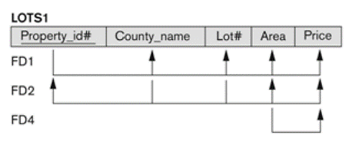
Example-3
Consider the relation LOTS1 and its functional dependencies F.
F = { P → LCA, LC → AP, A → C }
Minimum cover = G = {P → LC, LC → AP, A → C }.
In step 2 of Algorithm 3NF_Relations( ) we produce design X (before removing redundant relations) as
Design X: R1(P, L, C), R2(L, C, A, P), and R3(A, C).
In step 4 of the algorithm, we find that R3and R1are subsumed by R2. Hence, both of those relations are redundant.
Design X (Final 3NF): R2(L, C, A, P).

Slide 64
2) Nonadditive Join Decomposition into
BCNF Schemas
Algorithm BCNF(R, F)
{
D = {R}
while there is a relation schema Q in D that is not in BCNF;
{
Choose a relation schema Q that is not in BCNF
Find an FD, X → Y in Q that violates BCNF
Replace Q in D by two schemas (Q – Y) and (X ∪ Y)
}
}

Slide 65
Example-1
Consider R = {ABCDE} and F = {A→BC, BC→A, BCD→E, E→C}
CK = {AD, BCD}.
Check each FD in R for possible violation of BCNF.
FD1: A is not a superkey; FD2: BC is not a superkey;
FD3: BCD is a superkey; FD4: E is not a superkey
Therefore R is not in BCNF and should be decomposed as:
R1 = (ABC) {A→BC, BC→A} in BCNF (superkey = {A, BC})
R2 = (BCDE) {BCD→E, E→C} not in BCNF (E→C and E is not a uperkey)
We continue decomposing R2 into
R21= (BDE) no FDs. R21 is in BCNF
R22= (EC) {E→C} E is a superkey R22 is in BCNF.
Final solution: Scheme D= {ABC, BDE, EC} is in BCNF

Slide 66
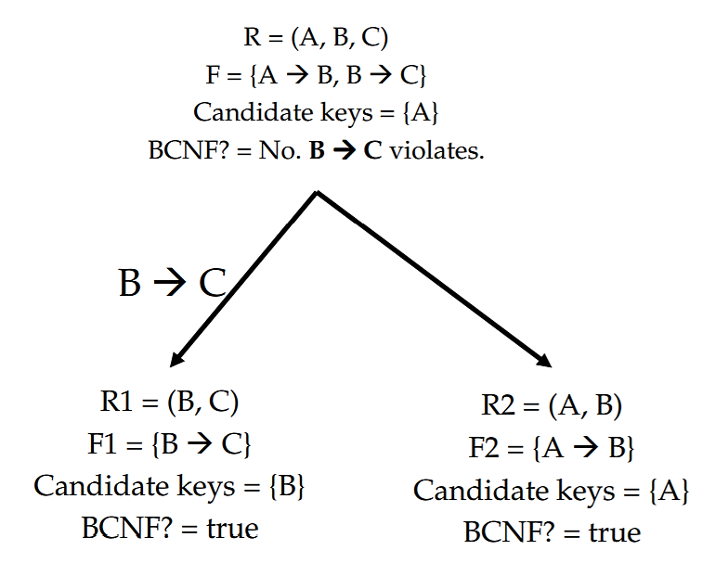
Example-2

Slide 67
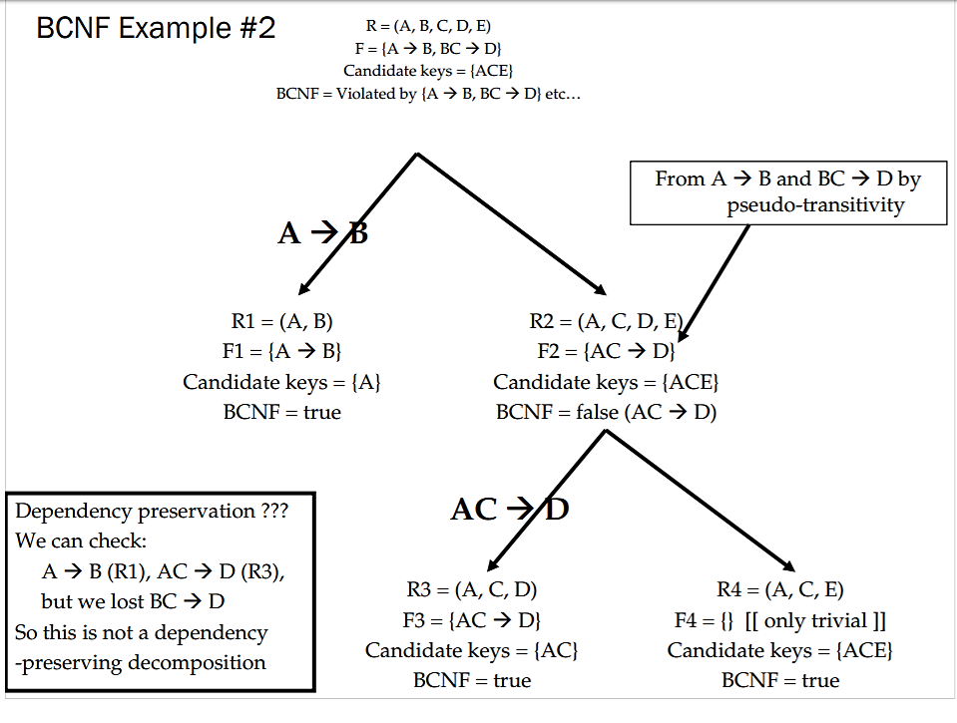
Example-3
Design X

Slide 68
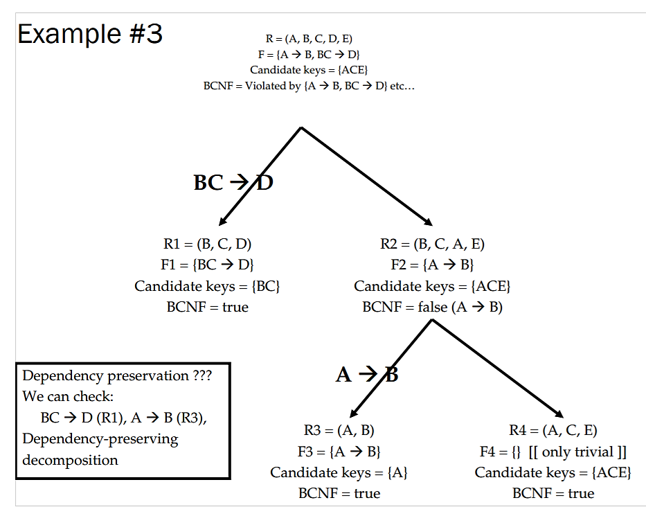
Example-3 (Contd.)
Design Y

Slide 69
Exercise
Given R(A, B, C, D) and F = {B → C, AC → D}. Normalize R and test whether it preserves the dependencies and a lossless join.
Solution:
CK = {AB}
Not in 3NF as per the definition.
D = {R1(BC), R2(ACD)} with F1 = {B → C} and F2 = {AC → D}
Now R1 and R2 are in 3NF and BCNF.
It does preserve the dependencies, because F = F1 ∪ F2.
Check R1∩ R2 → R1 – R2 or R2 – R1
(BC) ∩ (ACD) → BC – ACD or ACD – BC does not hold
Therefore, it is not lossless decomposition.
Note: Test using the matrix method also.

Slide 70
Contact Session 10: Disk Storage, Basic File Structures,
Hashing, and Modern Storage
Architectures

Slide 71
Introduction
Databases typically stored on magnetic disks
Accessed using physical database file structures
Storage hierarchy
Primary storage
CPU main memory, cache memory
Secondary storage
Magnetic disks, flash memory, solid-state drives
Tertiary storage
Removable media

Slide 72
Memory Hierarchies and Storage Devices
Cache memory
Static RAM
DRAM
Mass storage
Magnetic disks
CD-ROM, DVD, tape drives
Flash memory
Nonvolatile

Slide 73
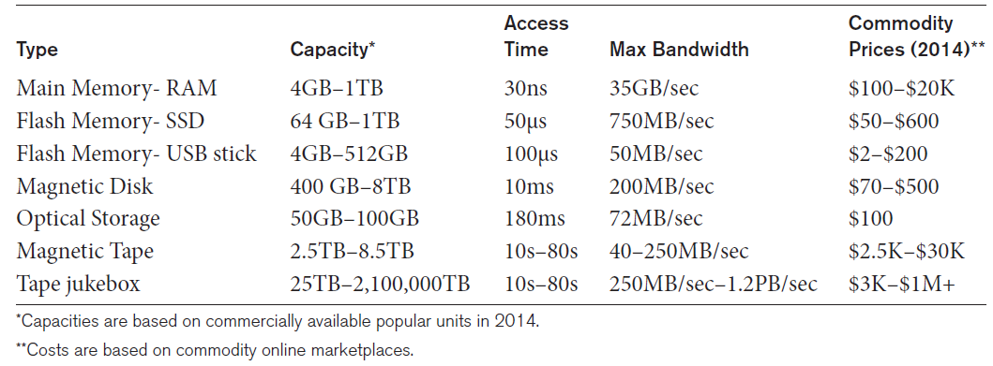
Storage Types and Characteristics
Table 16.1 Types of Storage with Capacity, Access Time, Max Bandwidth (Transfer Speed), and Commodity Cost

Slide 74
Storage Organization of Databases
Persistent data
Most databases
Transient data
Exists only during program execution
File organization
Determines how records are physically placed on the disk
Determines how records are accessed

Slide 75
Secondary Storage Devices
Hard disk drive
Bits (ones and zeros)
Grouped into bytes or characters
Disk capacity measures storage size
Disks may be single or double-sided
Concentric circles called tracks
Tracks divided into blocks or sectors
Disk packs
Cylinder

Slide 76
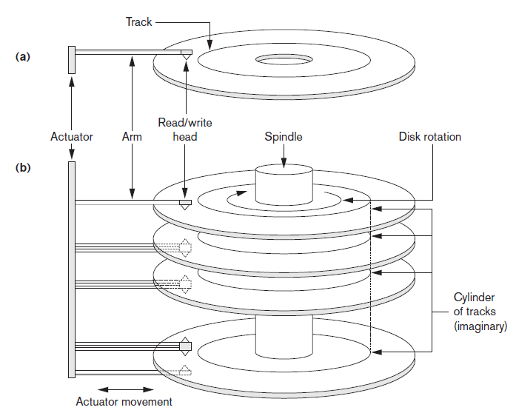
Single-Sided Disk and Disk Pack
Figure 16.1 (a) A single-sided disk with read/write hardware (b) A disk pack with read/write hardware

Slide 77
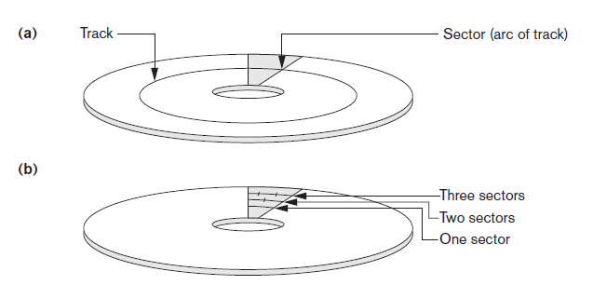
Sectors on a Disk
Figure 16.2 Different sector organizations on disk (a) Sectors subtending a fixed angle (b) Sectors maintaining a uniform recording density

Slide 78
Secondary Storage Devices (cont’d.)
Formatting
Divides tracks into equal-sized disk blocks
Blocks separated by interblock gaps
Data transfer in units of disk blocks
Hardware address supplied to disk I/O hardware
Buffer
Used in read and write operations
Read/write head
Hardware mechanism for read and write operations

Slide 79
Secondary Storage Devices (cont’d.)
Disk controller
Interfaces disk drive to computer system
Standard interfaces
SCSI - Small Computer System Interface
SATA - Serial Advanced Technology Attachment
SAS - Serial Attached SCSI
Hard Drive Connector Types Explained! - SAS, SATA, SCSI, FC, IDE – YouTube
What is SAS and NL SAS |SCSI | SATA |IDE |Fiber channel - YouTube

Slide 80
Secondary Storage Devices (cont’d.)
Techniques for efficient data access
Data buffering
Proper organization of data on disk
Reading data ahead of request
Proper scheduling of I/O requests
Use of log disks to temporarily hold writes
Use of SSDs or flash memory for recovery purposes

Slide 81
Solid State Device Storage
Sometimes called flash storage
Main component: controller
Set of interconnected flash memory cards
No moving parts
Data less likely to be fragmented
More costly than HDDs
DRAM-based SSDs available
Faster access times compared with flash

Slide 82
Magnetic Tape Storage Devices
Sequential access
Must scan preceding blocks
Tape is mounted and scanned until required block is under read/write head
Important functions
Backup
Archive

Slide 83
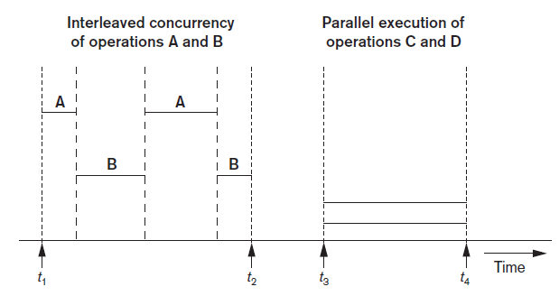
Buffering of Blocks
Buffering most useful when processes can run concurrently in parallel
Interleaved concurrency versus parallel execution

Slide 84
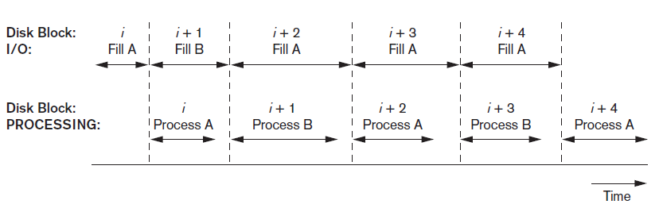
Buffering of Blocks (cont’d.)
Double buffering can be used to read continuous stream of blocks
Use of two buffers, A and B, for reading from disk

Slide 85
Buffer Management and Replacement Strategies
Buffer management information
Pin count
Dirty bit
Buffer replacement strategies
Least recently used (LRU)
Clock policy
First-in-first-out (FIFO)

Slide 86
Placing File Records on Disk
Record: collection of related data values or items
Values correspond to record field
Data types
Numeric
String
Boolean
Date/time
Binary large objects (BLOBs)
Unstructured objects

Slide 87
Placing File Records on Disk (cont’d.)
Reasons for variable-length records
One or more fields have variable length
One or more fields are repeating
One or more fields are optional
File contains records of different types

Slide 88
Record Blocking and Spanned Versus Unspanned Records
File records allocated to disk blocks
Spanned records
Larger than a single block
Pointer at end of first block points to block containing remainder of record
Unspanned
Records not allowed to cross block boundaries

Slide 89
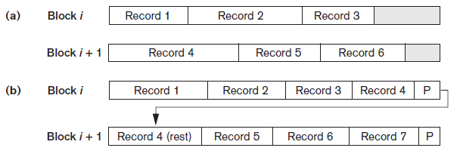
Record Blocking and Spanned Versus Unspanned Records (cont’d.)
Blocking factor
Average number of records per block for the file
Figure 16.6 Types of record organization (a) Unspanned (b) Spanned

Slide 90
Record Blocking and Spanned Versus Unspanned Records (cont’d.)
Allocating file blocks on disk
Contiguous allocation
Linked allocation
Indexed allocation
File header (file descriptor)
Contains file information needed by system programs
Disk addresses
Format descriptions

Slide 91
Operations on Files
Retrieval operations
No change to file data
Update operations
File change by insertion, deletion, or modification
Records selected based on selection condition

Slide 92
Operations on Files (cont’d.)
Examples of operations for accessing file records
Open
Find
Read
FindNext
Delete
Insert
Close
Scan

Slide 93
Files of Unordered Records (Heap Files)
Heap (or pile) file
Records placed in file in order of insertion
Inserting a new record is very efficient
Searching for a record requires linear search
Deletion techniques
Rewrite the block
Use deletion marker

Slide 94
Files of Ordered Records (Sorted Files)
Ordered (sequential) file
Records sorted by ordering field
Called ordering key if ordering field is a key field
Advantages
Reading records in order of ordering key value is extremely efficient
Finding next record
Binary search technique

Slide 95
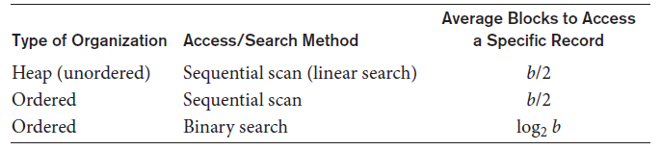
Access Times for Various File Organizations
Table 16.3 Average access times for a file of b blocks under basic file organizations

Slide 96
Hashing Techniques
Hash function (randomizing function)
Applied to hash field value of a record
Yields address of the disk block of stored record
Organization called hash file
Search condition is equality condition on the hash field
Hash field typically key field
Hashing also internal search structure
Used when group of records accessed exclusively by one field value

Slide 97
Hashing Techniques (cont’d.)
Internal hashing
Hash table
Collision
Hash field value for inserted record hashes to address already containing a different record
Collision resolution
Open addressing
Chaining
Multiple hashing

Slide 98
Hashing Techniques (cont’d.)
External hashing for disk files
Target address space made of buckets
Bucket: one disk block or contiguous blocks
Hashing function maps a key into relative bucket
Table in file header converts bucket number to disk block address
Collision problem less severe with buckets
Static hashing
Fixed number of buckets allocated

Slide 99
Hashing Techniques (cont’d.)
Hashing techniques that allow dynamic file expansion
Extendible hashing
File performance does not degrade as file grows
Dynamic hashing
Maintains tree-structured directory
Linear hashing
Allows hash file to expand and shrink buckets without needing a directory

Slide 100
Other Primary File Organizations
Files of mixed records
Relationships implemented by logical field references
Physical clustering
B-tree data structure
Column-based data storage

Slide 101
Parallelizing Disk Access Using RAID Technology
Redundant arrays of independent disks (RAID)
Goal: improve disk speed and access time
Set of RAID architectures (0 through 6)
Data striping
Bit-level striping
Block-level striping
Improving Performance with RAID
Data striping achieves higher transfer rates

Slide 102
Parallelizing Disk Access Using RAID Technology (cont’d.)
Improving reliability with RAID
Redundancy techniques: mirroring and shadowing
RAID organizations and levels
Level 0
Data striping, no redundant data
Spits data evenly across two or more disks
Level 1
Uses mirrored disks

Slide 103
Parallelizing Disk Access Using RAID Technology (cont’d.)
RAID organizations and levels (cont’d.)
Level 2
Hamming codes for memory-style redundancy
Error detection and correction
Level 3
Single parity disk relying on disk controller
Levels 4 and 5
Block-level data striping
Data distribution across all disks (level 5)

Slide 104
Parallelizing Disk Access Using RAID Technology (cont’d.)
RAID organizations and levels (cont’d.)
Level 6
Applies P+Q redundancy scheme
Protects against up to two disk failures by using just two redundant disks
Rebuilding easiest for RAID level 1
Other levels require reconstruction by reading multiple disks
RAID levels 3 and 5 preferred for large volume storage
What is RAID? RAID 0, RAID 1, RAID 4, RAID 5, RAID 6, Nested RAID 10 Explained - YouTube

Slide 105
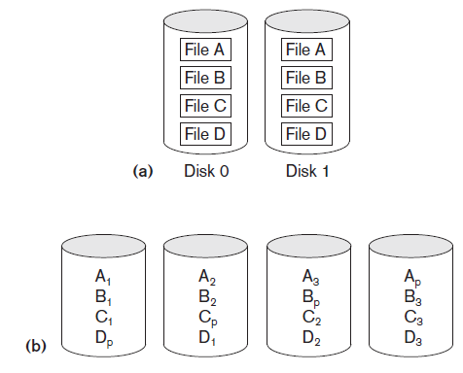
RAID Levels
Figure 16.14 Some popular levels of RAID (a) RAID level 1: Mirroring of data on two disks (b) RAID level 5: Striping of data with distributed parity across four disks

Slide 106
Modern Storage Architectures
Storage area networks
Online storage peripherals configured as nodes on high-speed network
Network-attached storage
Servers used for file sharing
High degree of scalability, reliability, flexibility, performance
iSCSI
Clients send SCSI commands to SCSI storage devices on remote channels

Slide 107
Modern Storage Architectures (cont’d.)
Fibre Channel over IP (FCIP)
Fibre Channel control codes and data translated into IP packets
Transmitted between geographically distant Fibre Channel SANs
Fibre Channel over Ethernet (FCoE)
Similar to iSCSI without the IP

Slide 108
Modern Storage Architectures (cont’d.)
Automated storage tiering
Automatically moves data between different storage types depending on need
Frequently-used data moved to solid-state drives
Object-based storage
Data managed in form of objects rather than files made of blocks
Objects carry metadata and global identifier
Ideally suited for scalable storage of unstructured data

Slide 109
Summary
Magnetic disks
Accessing a disk block is expensive
Commands for accessing file records
File organizations: unordered, ordered, hashed
RAID
Modern storage trends

Slide 110
Contact Session 11: Indexing used in Databases
&
B+ trees

Slide 111
Recap
Storage Types and Characteristics
Secondary Storage Devices
Buffering of Blocks
Placing File Records on Disk
Hashing Techniques
Other Primary File Organizations
Reference : Chapter 16 - Disk Storage, Basic File Structures, Hashing, and Modern Storage Architectures (Ramez Elmasri & Shamkant B. Navathe, Fundamentals of Database Systems, Pearson Education, 7th Edition, 2017)

Slide 112
Agenda
Indexing used in Databases with examples.
Understanding B+ trees and
Constructing B+ trees with examples
Construction of B+ trees and Problem Solving
Reference : Chapter 17 - Indexing Structures for Files and Physical Database Design (Ramez Elmasri & Shamkant B. Navathe, Fundamentals of Database Systems, Pearson Education, 7th Edition, 2017)

Slide 113
Introduction
Indexes used to speed up record retrieval in response to certain search conditions
Index structures provide secondary access paths
Any field can be used to create an index
Multiple indexes can be constructed
Most indexes based on ordered files
Tree data structures organize the index

Slide 114
17.1 Types of Single-Level Ordered Indexes
Ordered index similar to index in a textbook
Indexing field (attribute)
Index stores each value of the index field with list of pointers to all disk blocks that contain records with that field value
Values in index are ordered
Primary index
Specified on the ordering key field of ordered file of records

Slide 115
Types of Single-Level Ordered Indexes
Clustering index
Used if numerous records can have the same value for the ordering field
Secondary index
Can be specified on any non-ordering field
Data file can have several secondary indexes

Slide 116
Primary Indexes
Ordered file with two fields
Primary key, K(i)
Pointer to a disk block, P(i)
One index entry in the index file for each block in the data file
Indexes may be dense or sparse
Dense index has an index entry for every search key value in the data file
Sparse index has entries for only some search values

Slide 117
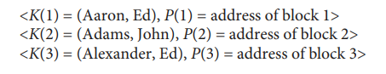
Primary Indexes
To create a primary index on the ordered file use the Name field as primary key, because that is the ordering key field of the file (assuming that each value of Name is unique). Each entry in the index has a Name value and a pointer. The first three index entries are as follows:

Slide 118
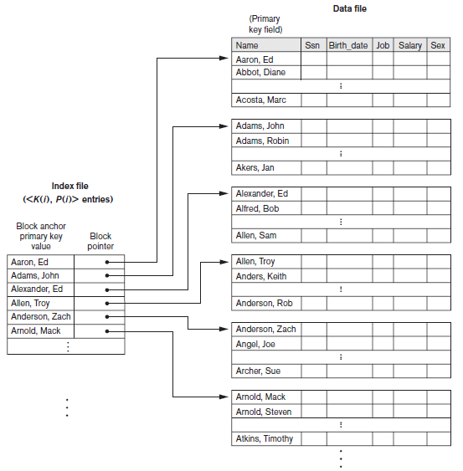
Primary Indexes (cont’d.)
Figure 17.1 Primary index on the ordering key field of the file shown in Figure 16.7 (Session -10)

Slide 119
Example 1.
Suppose that we have an ordered file with r = 300,000 records stored on a disk with block size B = 4,096 bytes. File records are of fixed size and are unspanned, with record length R = 100 bytes. The blocking factor for the file would be bfr = ⎣(B/R)⎦ = ⎣(4,096/100)⎦ = 40 records per block. The number of blocks needed for the file is b = ⎡(r/bfr)⎤ = ⎡(300,000/40)⎤ = 7,500 blocks. A binary search on the data file would need approximately ⎡log2 b⎤= ⎡(log2 7,500)⎤ = 13 block accesses.

Slide 120
Contd…
Now suppose that the ordering key field of the file is V = 9 bytes long, a block pointer is P = 6 bytes long, and we have constructed a primary index for the file. The size of each index entry is Ri = (9 + 6) = 15 bytes, so the blocking factor for the index is bfri = ⎣(B/Ri)⎦ = ⎣(4,096/15)⎦ = 273 entries per block.
The total number of index entries ri is equal to the number of blocks in the data file, which is 7,500. The number of index blocks is hence bi = ⎡(ri/bfri)⎤ = ⎡(7,500/273)⎤ = 28 blocks. To perform a binary search on the index file would need ⎡(log2 bi)⎤ = ⎡(log2 28)⎤ = 5 block accesses.
To search for a record using the index, we need one additional block access to the data file for a total of 5 + 1 = 6 block accesses—an improvement over binary search on the data file, which required 13 disk block accesses.

Slide 121
Primary Indexes (cont’d.)
Major problem: insertion and deletion of records
Move records around and change index values
Solutions
Use unordered overflow file
Use linked list of overflow records

Slide 122
Clustering Indexes
Clustering field
File records are physically ordered on a nonkey field without a distinct value for each record
Ordered file with two fields
Same type as clustering field
Disk block pointer

Slide 123
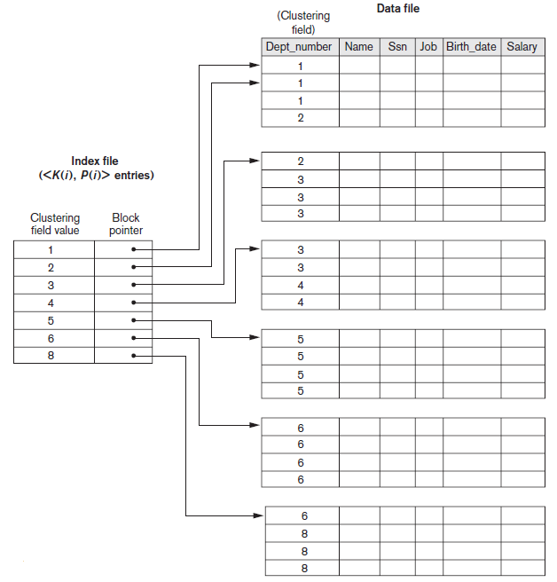
Clustering Indexes (cont’d.)
Figure 17.2 A clustering index on the Dept_number ordering nonkey field of an EMPLOYEE file

Slide 124
Example 2.
Suppose that we consider the same ordered file with r = 300,000 records stored on a disk with block size B = 4,096 bytes. Imagine that it is ordered by the attribute Zipcode and there are 1,000 zip codes in the file (with an average 300 records per zip code, assuming even distribution across zip codes.) The index in this case has 1,000 index entries of 11 bytes each (5-byte Zipcode and 6-byte block pointer) with a blocking factor bfri = ⎣(B/Ri)⎦ = ⎣(4,096/11)⎦ = 372 index entries per block.
The number of index blocks is hence bi = ⎡(ri/bfri)⎤ = ⎡(1,000/372)⎤ = 3 blocks. To perform a binary search on the index file would need ⎡(log2 bi)⎤ = ⎡(log2 3)⎤ = 2 block accesses. Again, this index would typically be loaded in main memory (occupies 11,000 or 11 Kbytes) and takes negligible time to search in memory. One block access to the data file would lead to the first record with a given zip code.

Slide 125
Secondary Indexes
Provide secondary means of accessing a data file
Some primary access exists
Ordered file with two fields
Indexing field, K(i)
Block pointer or record pointer, P(i)
Usually need more storage space and longer search time than primary index
Improved search time for arbitrary record

Slide 126
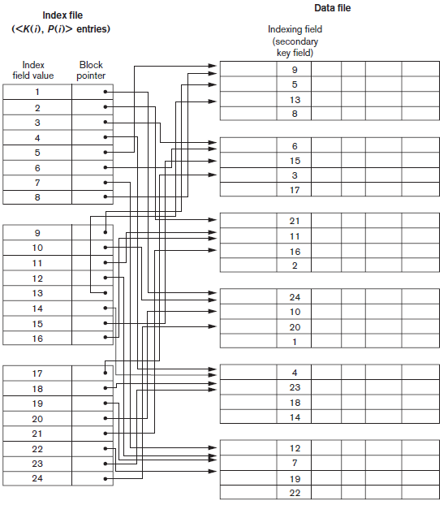
Secondary Indexes (cont’d.)
Figure 17.4 Dense secondary index (with block pointers) on a nonordering key field of a file.

Slide 127
Example 3.
Consider the file of Example 1 with r = 300,000 fixed-length records of size R = 100 bytes stored on a disk with block size B = 4,096 bytes. The file has b = 7,500 blocks, as calculated in Example 1. Suppose we want to search for a record with a specific value for the secondary key—a nonordering key field of the file that is V = 9 bytes long. Without the secondary index, to do a linear search on the file would require b/2 = 7,500/2 = 3,750 block accesses on the average. Suppose that we construct a secondary index on that nonordering key field of the file. As in Example 1, a block pointer is P = 6 bytes long, so each index entry is Ri = (9 + 6) = 15 bytes, and the blocking factor for the index is bfri = ⎣(B/Ri)⎦ = ⎣(4,096/15)⎦ = 273 index entries per block. In a dense secondary index such as this, the total number of index entries ri is equal to the number of records in the data file, which is 300,000. The number of blocks needed for the index is hence bi = ⎡(ri/bfri)⎤ = ⎡(300,000/273)⎤ = 1,099 blocks.

Slide 128
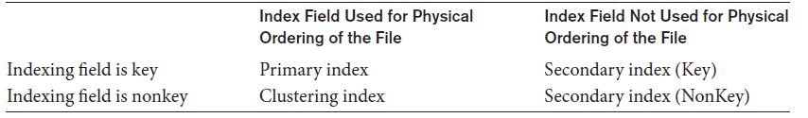
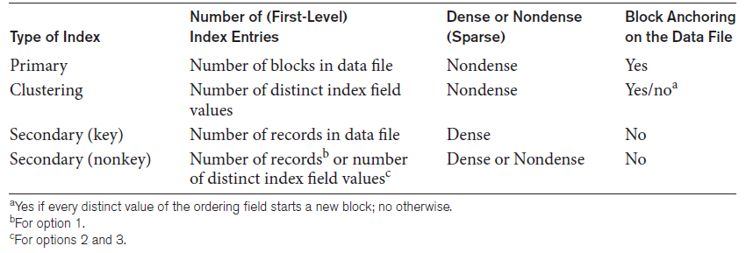
Types of Single-Level Ordered Indexes (cont’d.)
Table 17.1 Types of indexes based on the properties of the indexing field
Table 17.2 Properties of index types

Slide 129
17.2 Multilevel Indexes
Designed to greatly reduce remaining search space as search is conducted
Index file
Considered first (or base level) of a multilevel index
Second level
Primary index to the first level
Third level
Primary index to the second level

Slide 130
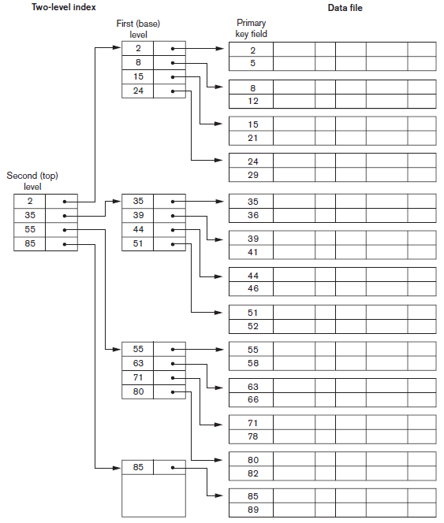
Figure 17.6 A two-level primary index resembling ISAM (indexed sequential access method) organization

Slide 131
Example 4.
Suppose that the dense secondary index of Example 3 is converted into a multilevel index. We calculated the index blocking factor bfri = 273 index entries per block, which is also the fan-out for the multilevel index; the number of first-level blocks b1 = 1,099 blocks was also calculated. The number of second-level blocks will be b2 = ⎡(b1/fo)⎤ = ⎡(1,099/273)⎤ = 5 blocks, and the number of third level blocks will be b3 = ⎡(b2/fo)⎤ = ⎡(5/273)⎤ = 1 block. Hence, the third level is the top level of the index, and t = 3. To access a record by searching the multilevel index, we must access one block at each level plus one block from the data file, so we need t + 1 = 3 + 1 = 4 block accesses. Compare this to Example 3, where 12 block accesses were needed when a single-level index and binary search were used.

Slide 132
B-Tree and B⁺-Tree

Slide 133
Minimum Space Utilization of B and B+ Tree
For B+ Tree
The minimum space utilization of a B+ Tree index is determined by the minimum occupancy of its node. This depends on the order of the B+ Tree and the rules for maintaining balance in B+ Tress.
For B- Tree
The minimum utilization of a B-Tree index depends on it’s order m and the rules for maintaining balance and occupancy in B-Trees.

Slide 134
Static and Dynaminc Tree Index
Static indexes like ISAM can be preferred in read-heavy workloads with minimal updates, as they are faster and simpler without the overhead of rebalancing. They are also more space-efficient and predictable for static datasets. However, dynamic indexes like B+ trees are better for frequent updates, range queries, and growing datasets, making them the usual choice in most modern applications.

Slide 135
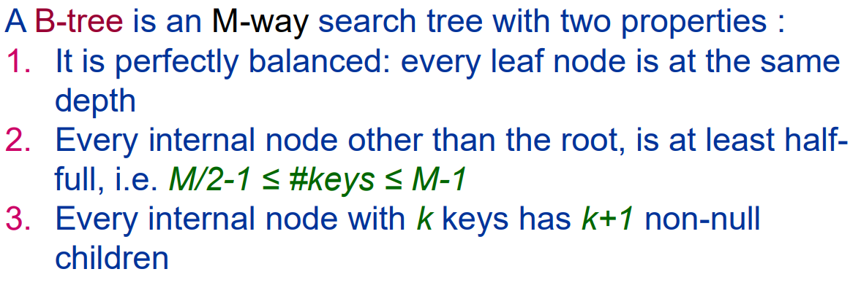
B-Tree and B⁺ -Tree

Slide 136
B⁺ -Tree
Same structure as B-trees.
Dictionary pairs are in leaves only. Leaves form a doubly-linked list.
Remaining nodes have following structure:
j a₀ k₁ a₁ k₂ a₂ … k_{j} a_{j}
j = number of keys in node.
a_{i} is a pointer to a subtree.
k_{i} <= smallest key in subtree a_{i} and > largest
in a_{i-1}.

Slide 137
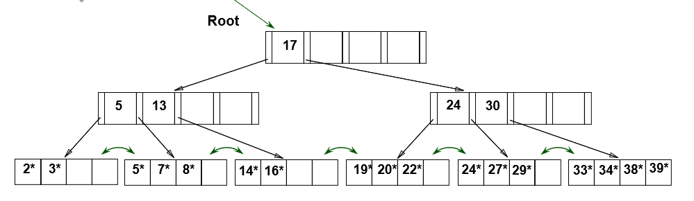
Example B⁺ Tree After Inserting 8*

Slide 138
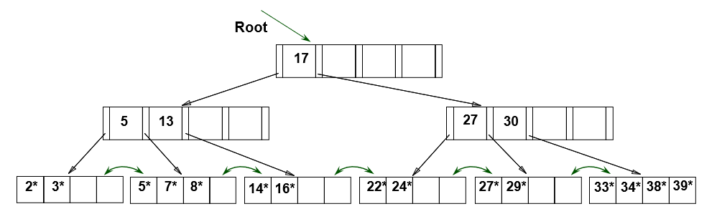
Example Tree After (Inserting 8*, Then) Deleting 19* and 20* ...

Slide 139
17.3 Dynamic Multilevel Indexes Using
B-Trees and B⁺ -Trees
Tree data structure terminology
Tree is formed of nodes
Each node (except root) has one parent and zero or more child nodes
Leaf node has no child nodes
Unbalanced if leaf nodes occur at different levels
Nonleaf node called internal node
Subtree of node consists of node and all descendant nodes

Slide 140
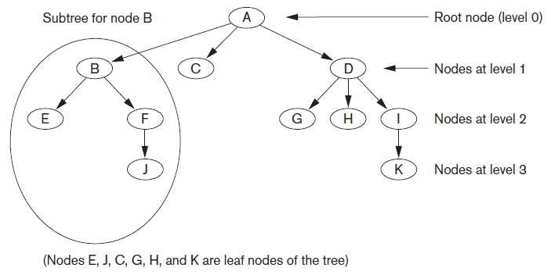
Tree Data Structure
Figure 17.7 A tree data structure that shows an unbalanced tree

Slide 141
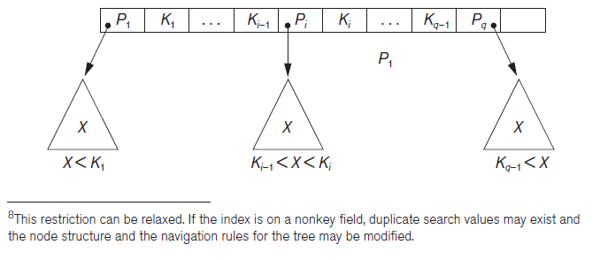
Search Trees and B-Trees
Search tree used to guide search for a record
Given value of one of record’s fields
Figure 17.8 A node in a search tree with pointers to subtrees below it

Slide 142
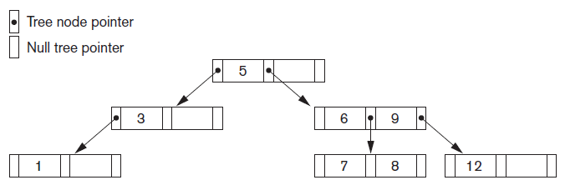
Search Trees and B-Trees (cont’d.)
Algorithms necessary for inserting and deleting search values into and from the tree
Figure 17.9 A search tree of order p = 3

Slide 143
B-Trees
Provide multi-level access structure
Tree is always balanced
Space wasted by deletion never becomes excessive
Each node is at least half-full
Each node in a B-tree of order p can have at most p-1 search values

Slide 144
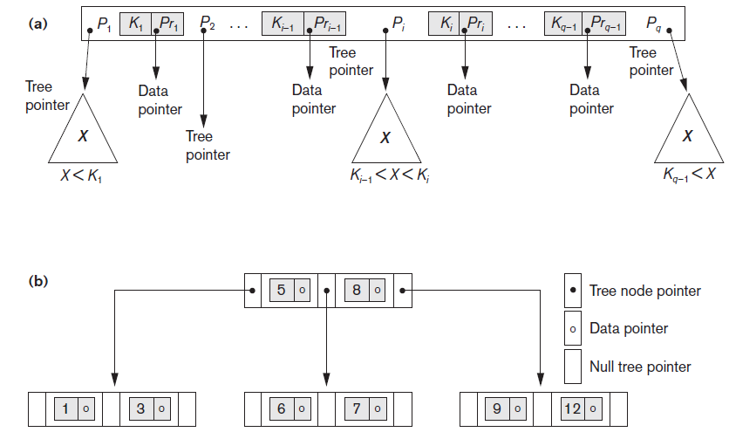
B-Tree Structures
Figure 17.10 B-tree structures (a) A node in a B-tree with q−1 search values (b) A B-tree of order p=3. The values were inserted in the order 8, 5, 1, 7, 3, 12, 9, 6

Slide 145
B⁺ - Trees
Data pointers stored only at the leaf nodes
Leaf nodes have an entry for every value of the search field, and a data pointer to the record if search field is a key field
For a nonkey search field, the pointer points to a block containing pointers to the data file records
Internal nodes
Some search field values from the leaf nodes repeated to guide search

Slide 146
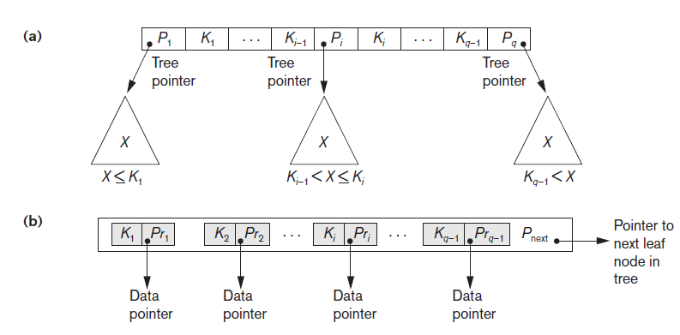
B⁺ -Trees (cont’d.)
Figure 17.11 The nodes of a B+-tree (a) Internal node of a B+-tree with q−1 search values (b) Leaf node of a B+ -tree with q−1 search values and q−1 data pointers

Slide 147
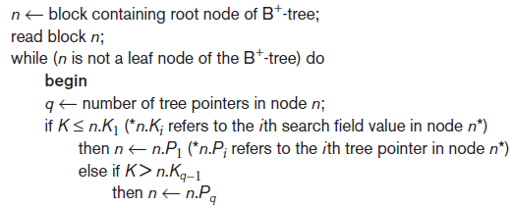
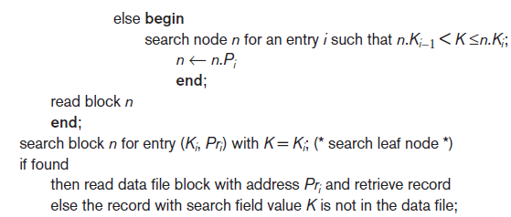
Searching for a Record With Search Key Field Value K, Using a B⁺ -Tree
Algorithm 17.2 Searching for a record with search key field value K, using a B+ -Tree

Slide 148
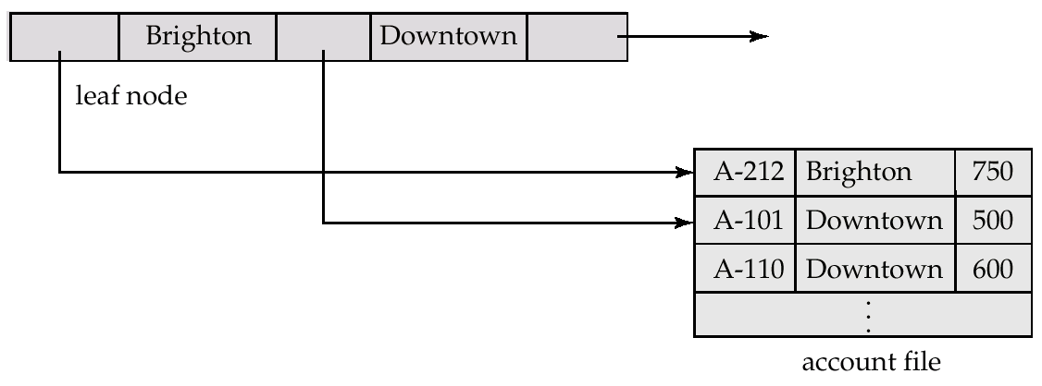
Leaf Nodes in B⁺-Trees

Slide 149
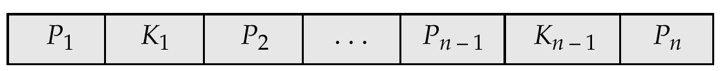
Non-Leaf Nodes in B⁺-Trees
All the search-keys in the subtree to which P₁ points are less than K₁
For 2 ≤ i ≤ n – 1, all the search-keys in the subtree to which P_{i} points have values
greater than or equal to K_{i–1} and less than K_{m–1}

Slide 150
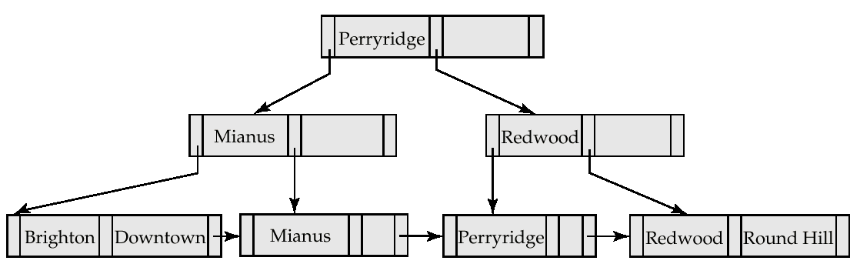
Example of a B⁺-tree
B⁺-tree for account file (n = 3)

Slide 151
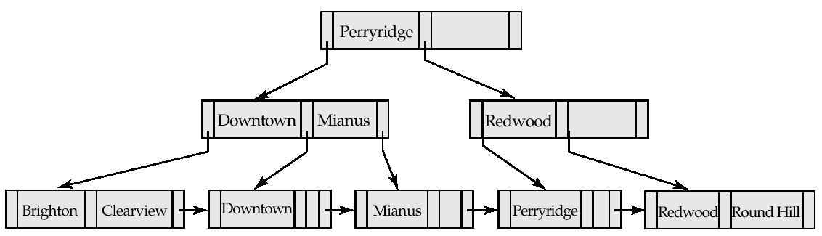
Updates on B⁺-Trees: Insertion
B⁺-Tree before and after insertion of “Clearview”

Slide 152
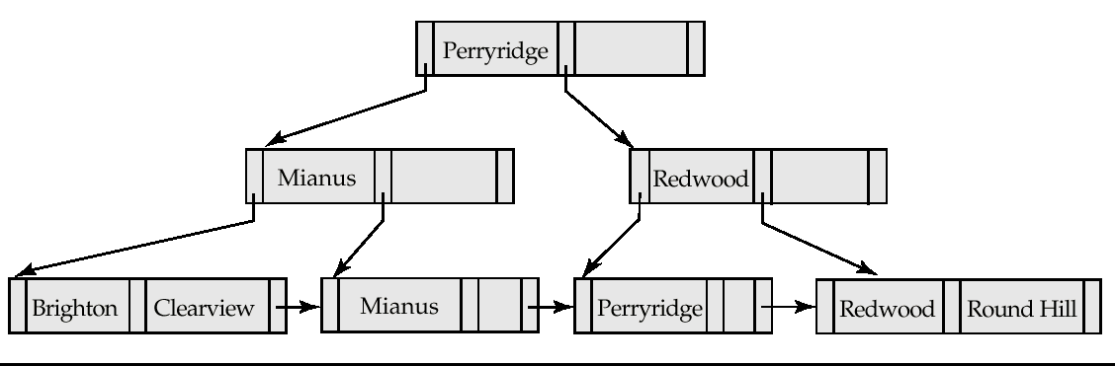
Examples of B⁺-Tree Deletion
Before and after deleting “Downtown”
The removal of the leaf node containing “Downtown” did not result in its parent having too little pointers. So the cascaded deletions stopped with the deleted leaf node’s parent.

Slide 153
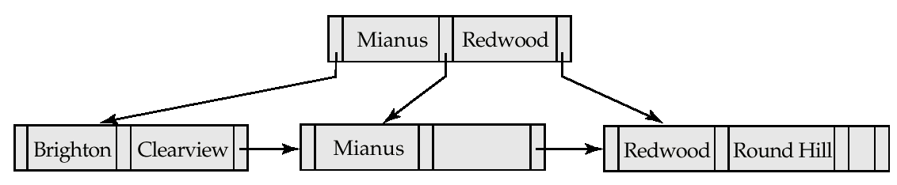
Examples of B⁺-Tree Deletion
Deletion of “Perryridge” from result of previous example
Node with “Perryridge” becomes underfull (actually empty, in this special case) and merged with its sibling.
As a result “Perryridge” node’s parent became underfull, and was merged with its sibling (and an entry was deleted from their parent)
Root node then had only one child, and was deleted and its child became the new root node

Slide 154
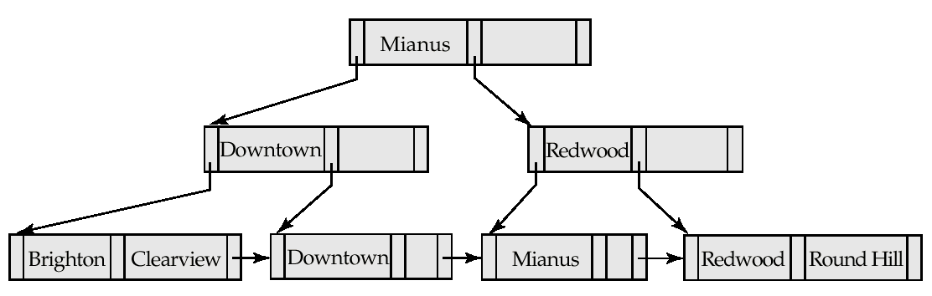
Example of B⁺-tree Deletion
Before and after deletion of “Perryridge” from earlier example
Parent of leaf containing Perryridge became underfull, and borrowed a pointer from its left sibling
Search-key value in the parent’s parent changes as a result

Slide 155
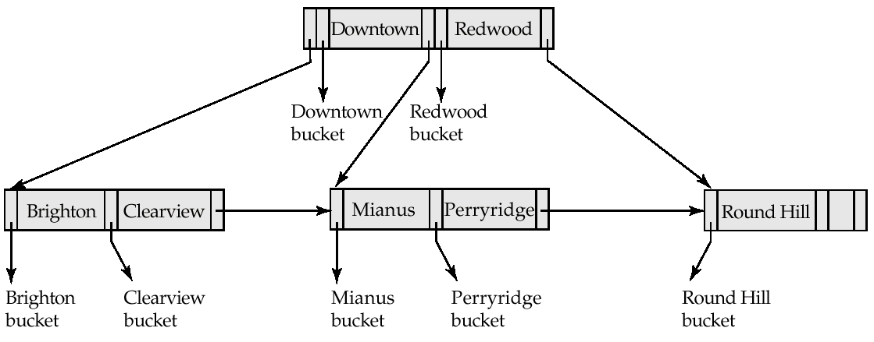
B-Tree Index File Example
B-tree (above) and B+-tree (below) on same data

Slide 156
Example of B⁺-Tree

Slide 157
Example of B⁺-tree
B⁺-tree for instructor file (n = 6)

Slide 158
B⁺-Tree Insertion
Affected nodes
B⁺-Tree before and after insertion of “Adams”

Slide 159
B⁺-Tree Insertion
B⁺-Tree before and after insertion of “Lamport”
Affected nodes
Affected nodes

Slide 160
Examples of B⁺-Tree Deletion
Before and after deleting “Srinivasan”
Affected nodes
Deleting “Srinivasan” causes merging of under-full leaves

Slide 161
Examples of B⁺-Tree Deletion
Before and after deleting “Singh” and “Wu”
Affected nodes
Leaf containing Singh and Wu became underfull, and borrowed a value Kim from its left sibling
Search-key value in the parent changes as a result

Slide 162
Example of B⁺-tree Deletion (Cont.)
Before and after deletion of “Gold”
Node with Gold and Katz became underfull, and was merged with its sibling
Parent node becomes underfull, and is merged with its sibling
Value separating two nodes (at the parent) is pulled down when merging
Root node then has only one child, and is deleted

Slide 163
B-Tree Index File Example
B-tree (above) and B+-tree (below) on same data

Slide 164
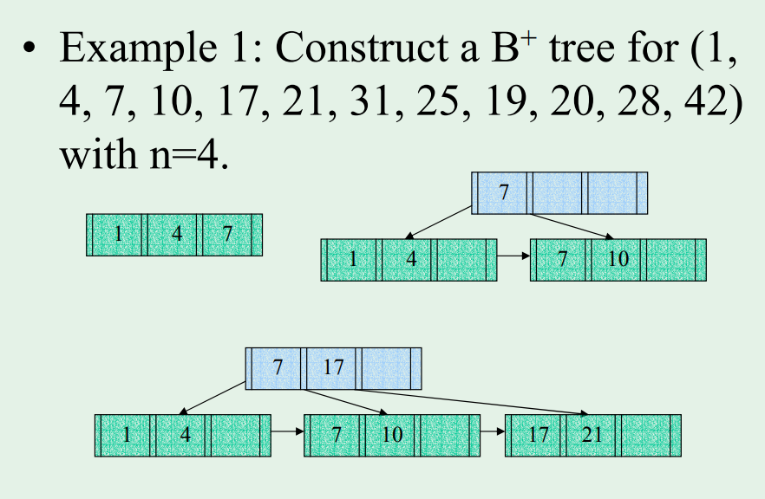
Construction : B⁺ -Tree

Slide 165
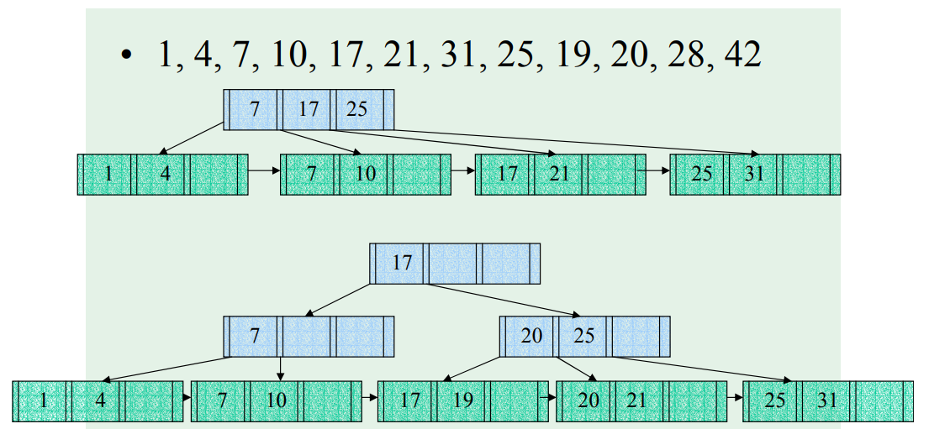

Slide 166
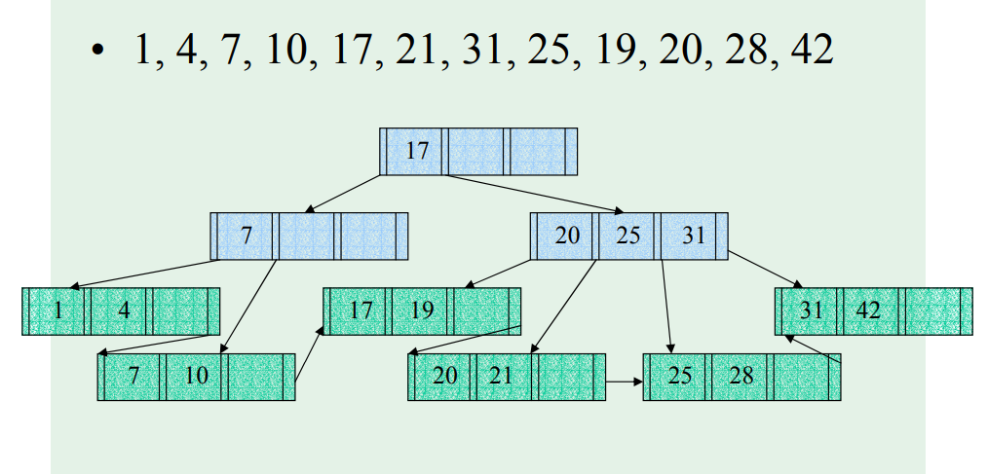

Slide 167
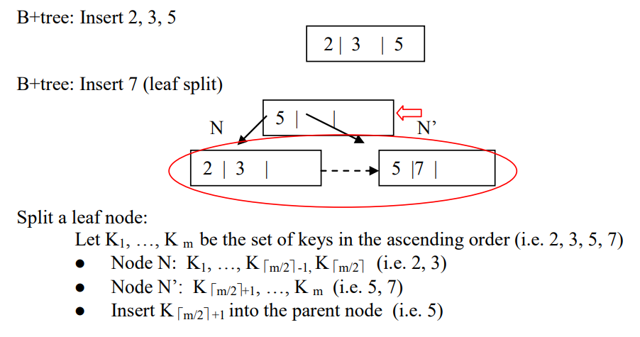
EXERCISE 1
Construct a B⁺ tree for the following set of values (2, 3, 5, 7, 11, 17, 19, 23, 29, 31)
Assume that the tree is initially empty and values are inserted in ascending order.

Slide 168

Contd…

Slide 169
Web References
Indexing In DBMS | Why Indexing is used | With Examples | Basics 1/2 – YouTube
Types Of Indexing In DBMS With Examples | Indexing Basics 2/2 – YouTube
classification indexing | DBMS – YouTube
indexing in database example| dbms – YouTube
B+ tree in database | Introduction & Example | DBMS | Bhanu Priya - YouTube

Slide 170
Contact Session 13:
Concurrency Control, Lock-based Protocols and Deadlocks, Database Recovery

Slide 171
Objective:
Understanding Concurrency control schemes and implementing serializability with locks and timestamps; Deadlocks with suitable examples

Slide 172
Contents:
Concurrency control and Implementing Serializability
Lock-based protocols and Deadlocks
Timestamp based protocols
Introduction to Database recovery and Log-based recovery
Checkpointing
Shadow paging

Slide 173
Let's have a quick recap!!

Slide 174
Transaction
Both concurrency control and crash recovery are based on the concept of a transaction.
A transaction is a set of SQL statements chosen by the user.
Example:
Transfer $100 from
one account to another:
BEGIN transaction
read balance from first account
add $100 to first account balance
write balance to first account
read balance from second account
verify balance to see if it contains at least $100
if not, ABORT transaction
subtract $100 from second account
write balance to second account
COMMIT transaction

Slide 175
The ACID Properties of Transactions
Atomicity: A transaction happens in its entirety or not at all
What if the OS crashed after $100 was deposited to the first account?
The recovery manager of the DBMS must assure that the $100 is withdrawn from the first account.
Consistency: If the DB starts in a consistent state, (this notion is defined by the user; some of it may be enforced by integrity constraints) the transaction will transform it into a consistent state.
What if a transaction just deposited $100 into an account?
The programmer must ensure that all transactions are consistent.
Isolation: Each transaction is isolated from other transactions. The effect on the DB is as if the transaction executed by itself.
What if another transaction computed the total bank balance after $100 was deposited to the first account?
The concurrency control subsystem must ensure that all transactions run in isolation, unless the DBA chooses a less strict level of isolation.
Durability: If a transaction commits, its changes to the database state persist
What if, after the commit, the OS crashed before the withdrawal was written to disk?
The recovery manager must assure that the withdrawal was at least logged.

Slide 176
Concurrency
First we will study isolation of transactions, ensured by the concurrency control subsystem.
Isolation is a problem only when multiple users are accessing the same data, and their actions interleave.
Remind you of anything?
Why is concurrency necessary?
Applications demand it
Better utilization of resources: While one user/transaction is reading the disk, another can be using the CPU or reading another disk. This results in better throughput and response time.

Slide 177
Let’s start today’s session!!

Slide 178
Purpose of Concurrency Control
To enforce Isolation (through mutual exclusion) among conflicting transactions.
To preserve database consistency through consistency preserving execution of transactions.
To resolve read-write and write-write conflicts.
Example:
In concurrent execution environment if T1 conflicts with T2 over a data item A, then the existing concurrency control decides if T1 or T2 should get the A and if the other transaction is rolled-back or waits.

Slide 179
Two-Phase Locking Techniques
Locking is an operation which secures
(a) permission to Read
(b) permission to Write a data item for a transaction.
Example:
Lock (X). Data item X is locked in behalf of the requesting transaction.
Unlocking is an operation which removes these permissions from the data item.
Example:
Unlock (X): Data item X is made available to all other transactions.
Lock and Unlock are Atomic operations.

Slide 180
Two-Phase Locking Techniques: Essential components
Two locks modes:
(a) shared (read) (b) exclusive (write).
Shared mode: shared lock (X)
More than one transaction can apply share lock on X for reading its value but no write lock can be applied on X by any other transaction.
Exclusive mode: Write lock (X)
Only one write lock on X can exist at any time and no shared lock can be applied by any other transaction on X.
Conflict matrix

Slide 181
Two-Phase Locking Techniques: Essential components
Lock Manager:
Managing locks on data items.
Lock table:
Lock manager uses it to store the identify of transaction locking a data item, the data item, lock mode and pointer to the next data item locked. One simple way to implement a lock table is through linked list.

Slide 182
Two-Phase Locking Techniques: Essential components
Database requires that all transactions should be well-formed. A transaction is well-formed if:
It must lock the data item before it reads or writes to it.
It must not lock an already locked data items and it must not try to unlock a free data item.

Slide 183
Two-Phase Locking Techniques: Essential components
The following code performs the lock operation:
B: if LOCK (X) = 0 (*item is unlocked*)
then LOCK (X) ← 1 (*lock the item*)
else begin
wait (until lock (X) = 0) and
the lock manager wakes up the transaction);
goto B
end;

Slide 184
Two-Phase Locking Techniques: Essential components
The following code performs the unlock operation:
LOCK (X) ← 0 (*unlock the item*)
if any transactions are waiting then
wake up one of the waiting the transactions;

Slide 185
Two-Phase Locking Techniques: Essential components
The following code performs the read operation:
B: if LOCK (X) = “unlocked” then
begin LOCK (X) ← “read-locked”;
no_of_reads (X) ← 1;
end
else if LOCK (X) ← “read-locked” then
no_of_reads (X) ← no_of_reads (X) +1
else begin wait (until LOCK (X) = “unlocked” and
the lock manager wakes up the transaction);
go to B
end;

Slide 186
Two-Phase Locking Techniques: Essential components
The following code performs the write lock operation:
B: if LOCK (X) = “unlocked” then
begin LOCK (X) ← “read-locked”;
no_of_reads (X) ← 1;
end
else if LOCK (X) ← “read-locked” then
no_of_reads (X) ← no_of_reads (X) +1
else begin wait (until LOCK (X) = “unlocked” and
the lock manager wakes up the transaction);
go to B
end;

Slide 187
Two-Phase Locking Techniques: Essential components
The following code performs the unlock operation:
if LOCK (X) = “write-locked” then
begin LOCK (X) ← “unlocked”;
wakes up one of the transactions, if any
end
else if LOCK (X) ← “read-locked” then
begin
no_of_reads (X) ← no_of_reads (X) -1
if no_of_reads (X) = 0 then
begin
LOCK (X) = “unlocked”;
wake up one of the transactions, if any
end
end;

Slide 188
Two-Phase Locking Techniques: Essential components
Lock conversion
Lock upgrade: existing read lock to write lock
if Ti has a read-lock (X) and Tj has no read-lock (X) (i ≠ j) then
convert read-lock (X) to write-lock (X)
else
force Ti to wait until Tj unlocks X
Lock downgrade: existing write lock to read lock
Ti has a write-lock (X) (*no transaction can have any lock on X*)
convert write-lock (X) to read-lock (X)

Slide 189
Two-Phase Locking Techniques: The algorithm
Two Phases:
(a) Locking (Growing)
(b) Unlocking (Shrinking).
Locking (Growing) Phase:
A transaction applies locks (read or write) on desired data items one at a time.
Unlocking (Shrinking) Phase:
A transaction unlocks its locked data items one at a time.
Requirement:
For a transaction these two phases must be mutually exclusive, that is, during locking phase unlocking phase must not start and during unlocking phase locking phase must not begin.

Slide 190
Two-Phase Locking Techniques: The algorithm
T1 T2 Result
read_lock (Y); read_lock (X); Initial values: X=20; Y=30
read_item (Y); read_item (X); Result of serial execution
unlock (Y); unlock (X); T1 followed by T2
write_lock (X); Write_lock (Y); X=50, Y=80.
read_item (X); read_item (Y); Result of serial execution
X:=X+Y; Y:=X+Y; T2 followed by T1
write_item (X); write_item (Y); X=70, Y=50
unlock (X); unlock (Y);

Slide 191
Two-Phase Locking Techniques: The algorithm
T1 T2 Result
read_lock (Y); X=50; Y=50
read_item (Y); Nonserializable because it.
unlock (Y); violated two-phase policy.
read_lock (X);
read_item (X);
unlock (X);
write_lock (Y);
read_item (Y);
Y:=X+Y;
write_item (Y);
unlock (Y);
write_lock (X);
read_item (X);
X:=X+Y;
write_item (X);
unlock (X);
Time

Slide 192
Two-Phase Locking Techniques: The algorithm
T’1 T’2
read_lock (Y); read_lock (X); T1 and T2 follow two-phase
read_item (Y); read_item (X); policy but they are subject to
write_lock (X); Write_lock (Y); deadlock, which must be
unlock (Y); unlock (X); dealt with.
read_item (X); read_item (Y);
X:=X+Y; Y:=X+Y;
write_item (X); write_item (Y);
unlock (X); unlock (Y);

Slide 193
Two-Phase Locking Techniques: The algorithm
Two-phase policy generates two locking algorithms
(a) Basic
(b) Conservative
Conservative:
Prevents deadlock by locking all desired data items before transaction begins execution.
Basic:
Transaction locks data items incrementally. This may cause deadlock which is dealt with.
Stric:t
A more stricter version of Basic algorithm where unlocking is performed after a transaction terminates (commits or aborts and rolled-back). This is the most commonly used two-phase locking algorithm.

Slide 194
Dealing with Deadlock and Starvation
Deadlock
T’1 T’2
read_lock (Y); T1 and T2 did follow two-phase
read_item (Y); policy but they are deadlock
read_lock (X);
read_item (Y);
write_lock (X);
(waits for X) write_lock (Y);
(waits for Y)
Deadlock (T’1 and T’2)

Slide 195
Dealing with Deadlock and Starvation
Deadlock prevention
A transaction locks all data items it refers to before it begins execution.
This way of locking prevents deadlock since a transaction never waits for a data item.
The conservative two-phase locking uses this approach.

Slide 196
Dealing with Deadlock and Starvation
Deadlock detection and resolution
In this approach, deadlocks are allowed to happen. The scheduler maintains a wait-for-graph for detecting cycle. If a cycle exists, then one transaction involved in the cycle is selected (victim) and rolled-back.
A wait-for-graph is created using the lock table. As soon as a transaction is blocked, it is added to the graph. When a chain like: Ti waits for Tj waits for Tk waits for Ti or Tj occurs, then this creates a cycle. One of the transaction should be rolled back.

Slide 197
Dealing with Deadlock and Starvation
Deadlock avoidance
There are many variations of two-phase locking algorithm.
Some avoid deadlock by not letting the cycle to complete.
That is as soon as the algorithm discovers that blocking a transaction is likely to create a cycle, it rolls back the transaction.
Wound-Wait and Wait-Die algorithms use timestamps to avoid deadlocks by rolling-back victim.

Slide 198
Dealing with Deadlock and Starvation
Starvation
Starvation occurs when a particular transaction consistently waits or restarted and never gets a chance to proceed further.
In a deadlock resolution it is possible that the same transaction may consistently be selected as victim and rolled-back.
This limitation is inherent in all priority based scheduling mechanisms.
In Wound-Wait scheme a younger transaction may always be wounded (aborted) by a long running older transaction which may create starvation.

Slide 199
Timestamp based concurrency control algorithm
Timestamp
A monotonically increasing variable (integer) indicating the age of an operation or a transaction. A larger timestamp value indicates a more recent event or operation.
Timestamp based algorithm uses timestamp to serialize the execution of concurrent transactions.

Slide 200
Timestamp based concurrency control algorithm
Basic Timestamp Ordering
1. Transaction T issues a write_item(X) operation:
If read_TS(X) > TS(T) or if write_TS(X) > TS(T), then an younger transaction has already read the data item so abort and roll-back T and reject the operation.
If the condition in part (a) does not exist, then execute write_item(X) of T and set write_TS(X) to TS(T).
2. Transaction T issues a read_item(X) operation:
If write_TS(X) > TS(T), then an younger transaction has already written to the data item so abort and roll-back T and reject the operation.
If write_TS(X) ≤ TS(T), then execute read_item(X) of T and set read_TS(X) to the larger of TS(T) and the current read_TS(X).

Slide 201
Timestamp based concurrency control algorithm
Strict Timestamp Ordering
1. Transaction T issues a write_item(X) operation:
If TS(T) > read_TS(X), then delay T until the transaction T’ that wrote or read X has terminated (committed or aborted).
2. Transaction T issues a read_item(X) operation:
If TS(T) > write_TS(X), then delay T until the transaction T’ that wrote or read X has terminated (committed or aborted).

Slide 202
Timestamp based concurrency control algorithm
Thomas’s Write Rule
If read_TS(X) > TS(T) then abort and roll-back T and reject the operation.
If write_TS(X) > TS(T), then just ignore the write operation and continue execution. This is because the most recent writes counts in case of two consecutive writes.
If the conditions given in 1 and 2 above do not occur, then execute write_item(X) of T and set write_TS(X) to TS(T).

Slide 203
Databases Recovery

Slide 204
Purpose of Database Recovery
To bring the database into the last consistent state, which existed prior to the failure.
To preserve transaction properties (Atomicity, Consistency, Isolation and Durability).
Example:
If the system crashes before a fund transfer transaction completes its execution, then either one or both accounts may have incorrect value. Thus, the database must be restored to the state before the transaction modified any of the accounts.

Slide 205
Types of Failure
The database may become unavailable for use due to
Transaction failure: Transactions may fail because of incorrect input, deadlock, incorrect synchronization.
System failure: System may fail because of addressing error, application error, operating system fault, RAM failure, etc.
Media failure: Disk head crash, power disruption, etc.

Slide 206
Transaction Log
For recovery from any type of failure data values prior to modification (BFIM - BeFore Image) and the new value after modification (AFIM – AFter Image) are required.
These values and other information is stored in a sequential file called Transaction log. A sample log is given below. Back P and Next P point to the previous and next log records of the same transaction.

Slide 207
Data Update
Immediate Update: As soon as a data item is modified in cache, the disk copy is updated.
Deferred Update: All modified data items in the cache is written either after a transaction ends its execution or after a fixed number of transactions have completed their execution.
Shadow update: The modified version of a data item does not overwrite its disk copy but is written at a separate disk location.
In-placccccccccccccccccccccccccce update: The disk version of the data item is overwritten by the cache version.

Slide 208
Data Caching
Data items to be modified are first stored into database cache by the Cache Manager (CM) and after modification they are flushed (written) to the disk.
The flushing is controlled by Modified and Pin-Unpin bits.
Pin-Unpin: Instructs the operating system not to flush the data item.
Modified: Indicates the AFIM of the data item.

Slide 209
Transaction Roll-back (Undo) and Roll-Forward (Redo)
To maintain atomicity, a transaction’s operations are redone or undone.
Undo: Restore all BFIMs on to disk (Remove all AFIMs).
Redo: Restore all AFIMs on to disk.
Database recovery is achieved either by performing only Undos or only Redos or by a combination of the two. These operations are recorded in the log as they happen.

Slide 210


Slide 211


Slide 212

Roll-back: One execution of T1, T2 and T3 as recorded in the log.

Slide 213
Write-Ahead Logging
When in-place update (immediate or deferred) is used then log is necessary for recovery and it must be available to recovery manager. This is achieved by Write-Ahead Logging (WAL) protocol. WAL states that
For Undo: Before a data item’s AFIM is flushed to the database disk (overwriting the BFIM) its BFIM must be written to the log and the log must be saved on a stable store (log disk).
For Redo: Before a transaction executes its commit operation, all its AFIMs must be written to the log and the log must be saved on a stable store.

Slide 214
Checkpointing
Time to time (randomly or under some criteria) the database flushes its buffer to database disk to minimize the task of recovery. The following steps defines a checkpoint operation:
Suspend execution of transactions temporarily.
Force write modified buffer data to disk.
Write a [checkpoint] record to the log, save the log to disk.
Resume normal transaction execution.
During recovery redo or undo is required to transactions appearing after [checkpoint] record.

Slide 215
Steal/No-Steal and Force/No-Force
Possible ways for flushing database cache to database disk:
Steal: Cache can be flushed before transaction commits.
No-Steal: Cache cannot be flushed before transaction commit.
Force: Cache is immediately flushed (forced) to disk.
No-Force: Cache is deferred until transaction commits
These give rise to four different ways for handling recovery:
Steal/No-Force (Undo/Redo)
Steal/Force (Undo/No-redo)
No-Steal/No-Force (Redo/No-undo)
No-Steal/Force (No-undo/No-redo)

Slide 216
Recovery Scheme
Deferred Update (No Undo/Redo)
The data update goes as follows:
A set of transactions records their updates in the log.
At commit point under WAL scheme these updates are saved on database disk.
After reboot from a failure the log is used to redo all the transactions affected by this failure. No undo is required because no AFIM is flushed to the disk before a transaction commits.

Slide 217
Deferred Update in a single-user system There is no concurrent data sharing in a single user system. The data update goes as follows:
A set of transactions records their updates in the log.
At commit point under WAL scheme these updates are saved on database disk.
After reboot from a failure the log is used to redo all the transactions affected by this failure. No undo is required because no AFIM is flushed to the disk before a transaction commits.

Slide 218


Slide 219

Deferred Update with concurrent users
This environment requires some concurrency control mechanism to guarantee isolation property of transactions. In a system recovery transactions which were recorded in the log after the last checkpoint were redone. The recovery manager may scan some of the transactions recorded before the checkpoint to get the AFIMs.

Slide 220


Slide 221
Deferred Update with concurrent users
Two tables are required for implementing this protocol:
Active table: All active transactions are entered in this table.
Commit table: Transactions to be committed are entered in this table.
During recovery, all transactions of the commit table are redone and all transactions of active tables are ignored since none of their AFIMs reached the database. It is possible that a commit table transaction may be redone twice but this does not create any inconsistency because of a redone is “idempotent”, that is, one redone for an AFIM is equivalent to multiple redone for the same AFIM.

Slide 222
Recovery Techniques Based on Immediate Update
Undo/No-redo Algorithm
In this algorithm AFIMs of a transaction are flushed to the database disk under WAL before it commits.
For this reason the recovery manager undoes all transactions during recovery.
No transaction is redone.
It is possible that a transaction might have completed execution and ready to commit but this transaction is also undone.

Slide 223
Recovery Techniques Based on Immediate Update
Undo/Redo Algorithm (Single-user environment)
Recovery schemes of this category apply undo and also redo for recovery.
In a single-user environment no concurrency control is required but a log is maintained under WAL.
Note that at any time there will be one transaction in the system and it will be either in the commit table or in the active table.
The recovery manager performs:
Undo of a transaction if it is in the active table.
Redo of a transaction if it is in the commit table.

Slide 224
Recovery Techniques Based on Immediate Update
Undo/Redo Algorithm (Concurrent execution)
Recovery schemes of this category applies undo and also redo to recover the database from failure.
In concurrent execution environment a concurrency control is required and log is maintained under WAL.
Commit table records transactions to be committed and active table records active transactions. To minimize the work of the recovery manager checkpointing is used.
The recovery performs:
Undo of a transaction if it is in the active table.
Redo of a transaction if it is in the commit table.

Slide 225
Shadow Paging
The AFIM does not overwrite its BFIM but recorded at another place on the disk. Thus, at any time a data item has AFIM and BFIM (Shadow copy of the data item) at two different places on the disk.
X and Y: Shadow copies of data items
X' and Y': Current copies of data items

Slide 226

Shadow Paging
To manage access of data items by concurrent transactions two directories (current and shadow) are used.
The directory arrangement is illustrated below. Here a page is a data item.

Slide 227
Recovery Examples
Following are the log entries at the time of system crash.
[start-transaction, T1]
[write-item, T1, D, 20]
[commit, T1]
[checkpoint]
[start-transaction, T4]
[write-item, T4, B, 15]
[write-item, T4, A, 10]
[commit, T4]
[start-transaction, T2]
[write-item, T2, B, 5]

Slide 228
Recovery Examples
[start-transaction, T3]
[write-item, T3, A, 20]
[write-item, T2, D, 55]
← system crash
Deffered update is used?
Immediate update is ised?

Slide 229
Recovery Examples
Recovery Procedures Based on the Logging and Crash Scenario:
a) Deferred Update Method:
In the deferred update approach, updates are written to the log but are not immediately applied to the database. Instead, updates are written to the database only after the transaction commits. Therefore:
Committed transactions: Updates are applied during recovery.
Uncommitted transactions: Updates are discarded.
Analysis:
1. Transactions T1 and T4 have committed before the crash:
T1: [write-item, T1, D, 20]
T4: [write-item, T4, B, 15] and [write-item, T4, A, 10]
These updates are applied during recovery.

Slide 230
Recovery Examples
2. Transactions T2 and T3 are uncommitted at the time of the crash:
T2: [write-item, T2, B, 5] and [write-item, T2, D, 55]
T3: [write-item, T3, A, 20]
These updates are discarded.
Recovery Procedure (Deferred Update):
Roll forward T1 and T4's changes to the database:
Apply D = 20, B = 15, and A = 10.
Discard changes from T2 and T3.

Slide 231
Recovery Examples
b) Immediate Update Method:
In the immediate update approach, changes are applied to the database as soon as they are made, even before the transaction commits. The log ensures consistency by supporting undo and redo operations:
Committed transactions: Use the log to redo their updates if needed.
Uncommitted transactions: Undo their updates using the log.
Analysis:
1. Transactions T1 and T4 are committed:
Their updates are redoable.
T1: [write-item, T1, D, 20]
T4: [write-item, T4, B, 15] and [write-item, T4, A, 10]

Slide 232
Recovery Examples
2. Transactions T2 and T3 are uncommitted:
Their updates are undoable:
T2: [write-item, T2, B, 5] and [write-item, T2, D, 55]
T3: [write-item, T3, A, 20]
Recovery Procedure (Immediate Update):
Redo the updates for T1 and T4:
Apply D = 20, B = 15, and A = 10.
Undo the updates for T2 and T3:
Revert B = 5 and D = 55 for T2.
Revert A = 20 for T3.

Slide 233
Contact Session 14:
Database Security, Access Control Mechanisms, to SQL Query Processing

Slide 234
Objective: Database Security with Access control schemes; To understand basics of SQL query optimization, and algorithms to perform certain operations.

Slide 235
Contents:
Introduction to Database Security
Access Control Mechanisms
Introduction to SQL Query Processing
Algorithms for Sorting and Joining
Algorithms for SELECT, PROJECT and Set operations
Algorithms for Aggregation and Grouping
query optimization,

Slide 236
Let's have a quick recap!!
Understanding Concurrency control schemes and implementing serializability with locks and timestamps; Deadlocks with suitable examples

Slide 237
Main Types of Database Security:
Enforce security of portions of a database against unauthorized access
- Database Security and Authorization Subsystem
Prevent unauthorized persons from accessing the system itself
- Access Control
Control the access to statistical databases
- Statistical Database Security
Protect sensitive data that is being transmitted via some type of communications
- Data Encryption

Slide 238
Database Security and Authorization Subsystem
Discretionary Security Mechanisms
- concerned with defining, modeling, and enforcing access to information
Mandatory Security Mechanisms for Multilevel Security
- requires that data items and users are assigned to certain security labels

Slide 239
Mandatory Access Control
Elements:
OBJECTS CLASSIFICATIONS
--class(o)--
SUBJECTS CLEARANCE
--clear(s)--
Levels: Top Secret, Secret, Confidential, Unclassified

Slide 240
Mandatory Access Control
Rules:
Simple Property: subject s is allowed to read data item d if clear(s) ≥ class(d)
*-property:
subject s is allowed to write data item d if clear(s) ≤ class(d)
Simple Property protects information from unauthorized access
*-property protects data from contamination or unauthorized modification

Slide 241
Preventing SQL Injection
To prevent SQL injection attacks use prepared statements (instead of creating query strings from input parameters)
PreparedStatement pstmt= conn.prepareStatement( "select balance from account where account_number =?“); pstmt.setString(1,accnt_number); pstmt.execute();
(assume that conn is an already open connection to the database)
Alternatives:
use stored procedures
use a function that removes special characters (such as quotes) from strings

Slide 242
Protecting from Programmers/DBA
Have password to database, can update anything!
Digital signatures by end users can help in some situations
E.g. low update rate data such as land records, birth/death data
Application program has database password
Seize control of the application program ➔ can do anything to the database
Solution:
Don’t give database password to development team
keep password in a configuration file on live server, accessible to only a few system administrators
Ongoing research on trusted applications
E.g. OS computes checksum on application to verify corruption
Allows file-system access only to trusted applications

Slide 243
Detecting Corruption
Audit trails: record of all (update) activity on the database: who did what, when
Application level audit trail
Helps detect fraudulent activities by users
Independent audit section to check all updates
BUT: DBAs can bypass this level
E.g. audit trail apparently deleted in New Delhi auto-rickshaw license case by malicious users with DBA access
Database level audit trail
Database needs to ensure these can’t be turned off, and turned on again after doing damage
Supported by most commercial database systems
But required DBAs with knowledge of application to monitor at this level
Keep archival copies and cross check periodically

Slide 244
Access Control in Application Layer
Authorization in application layer vs. database layer
Benefits
fine grained authorizations, such as to individual tuples, can be implemented by the application.
authorizations based on business logic easier to code at application level
Drawback:
Authorization must be done in application code, and may be dispersed all over an application
Hard to check or modify authorizations
Checking for absence of authorization loopholes becomes very difficult since it requires reading large amounts of application code

Slide 245

Introduction Query optimization
Query optimization: finding the “best” query execution plan (QEP) among the many possible ones
User is not expected to write queries efficiently (DBMS optimizer takes care of that)
Alternative ways to execute a given query – 2 levels
Equivalent relational algebra expressions
Different implementation choices for each relational algebra operation
Algorithms, indices, coordination between successive operations, …
The name of all instructors in the department of Music together with the titles of all courses they teach
INSTR(i_id, name, dept_name, ...)
COURSE(c_id, title, ...)
TEACHES(i_id, c_id, ...)
SELECT I.name, C.title
FROM INSTR I, COURSE C, TEACHES T
WHERE I.i_id = T.i_id
AND T.c_id = C.c_id
AND dept_name=“Music”

Slide 246

Introduction (Cont.)
A query evaluation plan (QEP) defines exactly what algorithm is used for each operation, and how the execution of the operations is coordinated
Find out how to view query execution plans on your favorite database

Slide 247
Introduction (Cont.)
Cost difference between query evaluation plans can be enormous
E.g. seconds vs. days in some cases
It is worth spending time in finding “best” QEP
Steps in cost-based query optimization
Generate logically equivalent expressions using equivalence rules
Annotate in all possible ways resulting expressions to get alternative QEP
Evaluate/estimate the cost (execution time) of each QEP
Choose the cheapest QEP based on estimated cost
Estimation of QEP cost based on:
Statistical information about relations (stored in the Catalog)
number of tuples, number of distinct values for an attribute
Statistics estimation for intermediate results
to compute cost of complex expressions
Cost formulae for algorithms, computed using statistics

Slide 248
Transformation of Relational Expressions
Two relational algebra expressions are said to be equivalent if the two expressions generate the same set of tuples on every legal database instance
Note: order of tuples is irrelevant (and also order of attributes)
We don’t care if they generate different results on databases that violate integrity constraints (e.g., uniqueness of keys)
In SQL, inputs and outputs are multisets of tuples
Two expressions in the multiset version of the relational algebra are said to be equivalent if the two expressions generate the same multiset of tuples on every legal database instance
We focus on relational algebra and treat relations as sets
An equivalence rule states that expressions of two forms are equivalent
One can replace an expression of first form by one of the second form, or vice versa

Slide 249
Equivalence Rules
1. Conjunctive selection operations can be deconstructed into a sequence of individual selections.
2. Selection operations are commutative.
Only the last in a sequence of projection operations is needed, the others can be omitted where
Selections can be combined with Cartesian products and theta joins.
σ_{θ}(E₁ x E₂) = E₁ _{θ} E₂
σ_{θ1}(E₁ _{θ2} E₂) = E₁ _{θ1∧ θ2} E₂

Slide 250
Equivalence Rules (Cont.)
5. Theta-join (and thus natural joins) operations are commutative. E_{1 θ} E₂ = E₂ _{θ} E₁
(but the order is important for efficiency)
6. (a) Natural join operations are associative:
(E₁ E₂) E₃ = E₁ (E₂ E₃)
(again, the order is important for efficiency)
(b) Theta joins are associative in the following manner:
(E_{1 θ1} E₂) _{θ2∧θ3} E₃ = E_{1 θ1∧ θ3} (E₂ _{θ2} E₃)
where θ₁ involves attributes from only E₁ and E₂ and θ₂ involves attributes from only E₂ and E₃

Slide 251
Equivalence Rules (Cont.)
7. (a) Selection distribute over theta join in the following manner:
σ_{θ1}(E₁ ⋈_{θ} E₂) = (σ_{θ1}(E₁)) ⋈_{θ} E₂
where θ₁ involves attributes from only E₁
(b) Complex selection distribute over theta join in the following manner:
σ_{θ1∧θ2}(E₁ ⋈_{θ} E₂) = (σ_{θ1}(E₁)) ⋈_{θ} (σ_{θ2}(E₂))
where θ₁ involves attributes from only E₁ and θ₂ involves attributes from only E₂

Slide 252

Pictorial Depiction of Equivalence Rules

Slide 253
Exercise
Disprove the equivalence
( R S ) T = R ( S T )
Definition (left outer join): the result of a left outer join T = R S is a super-set of the result of the join T’ = R S in that all tuples in T’ appear in T. In addition, T preserve those tuples that are lost in the join, by creating tuples in T that are filled with null values
STUD stud_id name surname
1 gino bianchi
2 filippo neri
3 mario rossi
STUD TAKES
stud_id name surname course grade
1 gino bianchi Math 30
2 filippo neri DB 22
2 filippo neri Logic 30
3 mario rossi null null
TAKES stud_id course grade
1 Math 30
2 DB 22
2 Logic 30
TAKES STUD ???

Slide 254
Solution
Disprove the equivalence
( R S ) T = R ( S T )
R
S
T
A | A_{R}
1 | 1
A | A_{S}
2 | 1
A | A_{T}
1 | 1
R S
S T
A | A_{R} | A_{S}
1 | 1 | null
A | A_{S} | A_{T}
2 | 1 | null
( R S ) T
R ( S T )
A | A_{R} | A_{S} | A_{T}
1 | 1 | null | 1
A | A_{R} | A_{S} | A_{T}
1 | 1 | null | null

Slide 255
Equivalence derivability and minimality
Some equivalence can be derived from others
example: 2 can be obtained from 1 (exploiting commutativity of conjunction) 7b can be obtained from 1 and 7a
Optimizers use minimal sets of equivalence rules

Slide 256
Enumeration of Equivalent Expressions
Query optimizers use equivalence rules to systematically generate expressions equivalent to the given one
Can generate all equivalent expressions as follows:
Repeat (starting from the set containing only the given expression)
apply all applicable equivalence rules on every sub-expression of every equivalent expression found so far
add newly generated expressions to the set of equivalent expressions
Until no new equivalent expressions are generated
The above approach is very expensive in space and time
Space: efficient expression-representation techniques
1 copy is stored for shared sub-expressions
Time: partial generation
Dynamic programming
Greedy techniques (select best choices at each step)
Heuristics, e.g., single-relation operations (selections, projections) are pushed inside (performed earlier)
E1
E2

Slide 257
Cost Estimation
Cost of each operator computed as described in Chapter 15 ⋆
Need statistics of input relations
E.g. number of tuples, sizes of tuples
Statistics are collected in the Catalog
Inputs can be results of sub-expressions
Need to estimate statistics of expression results
Estimation of size of intermediate results
# of tuple in input to successive operations
Estimation of number of distinct values in intermediate results
selectivity rate of successive selection operations
Statistics are not totally accurate
Information in the catalog might be not always up-to-date (delay)
A precise estimate for intermediate results might be impossible to compute
⋆ Silberschatz, Korth, and Sudarshan, Database System Concepts, 7° ed.

Slide 258
Statistical Information for Cost Estimation
Statistics information is maintained in the Catalog
The catalog is itself stored in the database as relation(s)
It contains:
n_{r}: number of tuples in a relation r
b_{r}: number of blocks containing tuples of r
l_{r}: size of a tuple of r (in bytes)
f_{r}: blocking factor of r – i.e., the number of tuples of r that fit into one block
V(A, r): number of distinct values that appear in r for set of attributes A
V(A, r) = ∏_{A}(r) – if A is a key, then V(A,r) = n_{r}
min(A,r): smallest value appearing in relation r for set of attribute A;
max(A,r): largest value appearing in relation r for set of attribute A;
statistics about indices (height of B⁺-trees, number of blocks for leaves, …)
We assume tuples of r are stored together physically in a file; then: b_{r} = ⌈ n_{r} / f_{r} ⌉
Information not always up-to-date
Catalog is not updated to every DB change (done during periods of light system load)

Slide 259
Selection Size Estimation
# of records that will satisfy the selection predicate (aka selection condition)
σ_{A=v}(r ) (we are assuming that v actually is present in A)
n_{r} / V(A,r) (no histogram, uniform distribution)
1 if A is key
σ_{A} _{≤ v}(r ) (case σ_{A ≥ V}(r) is symmetric)
0 if v < min(A,r)
n_{r} if v >= max(A,r)
otherwise (no histogram, uniform distribution)
In absence of statistical information or when v is unknown at time of cost estimation (e.g., v is computed at run-time by the application using the DB), the we assume
n_{r} / 2
If histograms are available, we can do more precise estimates
use values for restricted ranges instead of n_{r} , V(A,r), min(A, r), max(A,r)

Slide 260
Complex Selection Size Estimation
Conjunction E = σ_{θ1 ∧ θ2 ∧ … ∧ θn} (r )
we compute s_{i} = size selection for θ_{i} (i = 1,…, n)
selectivity rate (SR) of σ_{θi} (r): SR(σ_{θi} (r) ) = s_{i} / n_{r} (i = 1,…, n)
SR(E) = Π_{i} (SR(σ_{θi} (r))) = s₁ / n_{r} * … * s_{n}/ n_{r} Π_{i} is multiplication with i = 1,…,n
# of record for E = n_{r} * SR(E) =
Disjunction E = σ_{θ1 ∨ θ2 ∨ … ∨ θn} (r ) = σ_{¬(¬θ1 ∧ ¬θ2 ∧ … ∧ ¬θn)} (r )
SR(E) = 1 - SR(σ_{¬θ1 ∧ ¬θ2 ∧ … ∧ ¬θn} (r ))
SR(σ_{¬θ1 ∧ ¬θ2 ∧ … ∧ ¬θn} (r )) = (1 - s₁ / n_{r} ) * … * (1 - s_{n}/ n_{r} )
# of record for E = n_{r} * SR(E) =
Negation E = σ_{¬θ} (r)
# of record for E = n_{r} - # of record for σ _{θ} (r)

Slide 261
Join Size Estimation
# of records that will be included in the result
(cartesian product) r x s: # of records = n_{r} * n_{s}
(natural join on attribute A) r ⋈ s:
for each tuple t_{r} of r there are in average n_{s} / V(A,s) many tuples of s selected
thus, # of records = n_{r} * n_{s} / V(A,s)
by switching the role of r and s we get # of records = n_{r} * n_{s} / V(A,r)
lowest is more accurate estimation # of records = n_{r} * n_{s} / max{ V(A,r), V(A,s) }
histograms can be used for more accurate estimations
histograms must be on join attributes, for both relations, and with same ranges
use values for restricted ranges instead of n_{r} , n_{s} , V(A,r), V(A,s) and then sum estimations for each range
if A is key for r, then # of records <= n_{s} (and vice versa)
in addition, if A is not null in s, then # of records = n_{s} (and vice versa)
(theta join) r ⋈_{θ} s
r ⋈_{θ} s = σ _{θ} ( r x s) use formulas for cartesian product and selection

Slide 262
Size Estimation for Other Operations
projection (no duplications): # of records = V(A,r)
aggregation _{G}γ_{F} (r) # of records = V(G,r)
set operations
between selections on same relation use formulas for selection
es.: σ_{θ1}(r) ∪ σ_{θ2}(r) = σ_{θ1 ∨ θ2} (r)
r ∪ s # of records = n_{r} + n_{s}
r ∩ s # of records = min { n_{r} , n_{s} }
r – s # of records = n_{r}
outer join
left outer join # of records = # of records for inner join + n_{r}
right outer join # of records = # of records for inner join + n_{s}
full outer join # of records = # of records for inner join + n_{r} + n_{s}

Slide 263
Estimation for Number of Distinct Values
# distinct values in the result for expression E and attribute (or set of attributes) A: V(A,E)
Selection E = σ_{θ} (r)
V(A, E) is a specific value for some conditions – e.g., A=3 or 3 < A <= 6
condition A < v (or A > v, A >= v, … ) V(A,E) = V(A,r) * selectivity rate of the selection
otherwise V(A,E) = min { n_{E} , V(A,r) }
Join E = r ⋈ s
A only contains attributes from r V(A,E) = min { n_{E} , V(A,r) }
A only contains attributes from s V(A,E) = min { n_{E} , V(A,s) }
A contains attributes A1 from r and attributes A2 from s V(A,E) = min { n_{E} , V(A1, r) * V(A2 – A1, s) , V(A2, s) * V(A1 – A2, r) }

Slide 264
Choice of Evaluation Plans
Must consider the interaction of evaluation techniques when choosing evaluation plans
choosing the cheapest algorithm for each operation independently may not yield best overall algorithm. E.g.
merge-join may be costlier than hash-join, but may provide a sorted output which reduces the cost for an outer level aggregation
nested-loop join may provide opportunity for pipelining
Practical query optimizers incorporate elements of the following two broad approaches:
1. Search all the plans and choose the best plan in a cost-based fashion
2. Uses heuristics to choose a plan

Slide 265
Cost-Based Optimization
A big part of a cost-based optimizer (based on equivalence rules) is choosing the “best” order for join operations
Consider finding the best join-order for r₁ ⋈ r₂ ⋈ . . . ⋈ r_{n}.
There are (2(n – 1))!/(n – 1)! different join orders for above expression. With n = 7, the number is 665280, with n = 10, the number is greater than 17.6 billion!
No need to generate all the join orders. Exploiting some monotonicity (optimal substructure property), the least-cost join order for any subset of {r₁, r₂, . . ., r_{n}} is computed only once.

Slide 266
Cost-Based Optimization: An example
Consider finding the best join-order for r₁ r₂ r₃ r₄ r₅
Number of possible different join orderings:
The least-cost join order for any subset of { r₁, r₂, r₃, r₄, r₅ } is computed only once
Assume we want to compute N_{123/45} : number of possible different join orderings where r₁, r₂, r₃ sare grouped together, e.g.,
(r₁ r₂ r₃) r₄ r₅
(r₂ r₃ r₁) (r₅ r₄ )
r₄ (r₅ (r₁ (r₂ r₃)))
…
The naïve approach
N_{123/45} = N₁₂₃ * N₄₅
N₁₂₃ = (N₁₂₃ : # ways of arranging r₁, r₂, and r₃)
N₄₅ = N₁₂₃ = 12 (N₄₅ : # ways of arranging r₄ and r₅ wrt. block of r₁, r₂, and r₃)
N_{123/45} = 12 * 12 = 144
Exploiting optimal substructure property:
compute only once best ordering for r₁ r₂ r₃ : 12 possibilities (N₁₂₃)
compute best ordering for R₁₂₃ r₄ r₅ : 12 possibilities (N₄₅)
Therefore, N_{123/45} = 12 + 12 = 24

Slide 267
Dynamic Programming in Optimization
To find best join tree (equivalently, best join order) for a set of n relations:
Consider all possible plans of the form:
S’ ⋈ (S \ S’ )
for every non-empty subset S’ of S
Recursively compute (and store) costs of best join orders for subsets S’ and S \ S’. Choose the cheapest of the 2^{n} – 2 alternatives
Base case for recursion: find best algorithm for scanning relation
When a plan for a subset is computed, store it and reuse it when it is required again, instead of re-computing it
Dynamic programming

Slide 268
Join Order Optimization Algorithm
procedure findbestplan(S) if (bestplan[S].cost ≠ ∞) return bestplan[S] // else bestplan[S] has not been computed earlier, compute it now if (S contains only 1 relation) set bestplan[S].plan and bestplan[S].cost based on the best way of accessing S /* Using selections on S and indices on S */
else for each non-empty subset S1 of S such that S1 ≠ S P1= findbestplan(S1) P2= findbestplan(S - S1) A = best algorithm for joining results of P1 and P2 cost = P1.cost + P2.cost + cost of A if cost < bestplan[S].cost bestplan[S].cost = cost bestplan[S].plan = “execute P1.plan; execute P2.plan; join results of P1 and P2 using A” return bestplan[S]

Slide 269

Cost of Optimization
With dynamic programming time complexity of optimization is O(3^{n}).
With n = 10, this number is 59000 instead of 17.6 billion!
Space complexity is O(2^{n})
Better time performance when considering only left-deep join tree O(n 2^{n}) Space complexity remains at O(2^{n}) (heuristic approach)
Cost-based optimization is expensive, but worthwhile for queries on large datasets (typical queries have small n, generally < 10)

Slide 270
Cost Based Optimization with Equivalence Rules
Physical equivalence rules equates logical operations (e.g., join) to physical ones (i.e., implementations – e.g., nested-loop join, merge join)
Relational algebra expression are converted into QEP with implementation details
Efficient optimizer based on equivalence rules depends on
A space efficient representation of expressions which avoids making multiple copies of sub-expressions
Efficient techniques for detecting duplicate derivations of expressions
Dynamic programming or memoization techniques, which store the “best” plan for a sub-expression the first time it is computed, and reuses in on repeated optimization calls on same sub-expression
Cost-based pruning techniques that avoid generating all plans (greedy, heuristics)
Query Processing and Optimization - YouTube

Slide 271
Heuristic Optimization
Cost-based optimization is expensive, even with dynamic programming
Systems may use heuristics to reduce the number of possibilities choices that must be considered
Heuristic optimization transforms the query-tree by using a set of rules that typically (but not in all cases) improve execution performance:
Perform selection early (reduces the number of tuples)
Perform projection early (reduces the number of attributes)
Perform most restrictive selection and join operations (i.e. with smallest result size) before other similar operations
Only consider left-deep join orders (particularly suited for pipelining as only one input has to be pipelined, the other is a relation)

Slide 272
Structure of Query Optimizers
Some systems use only heuristics, others combine heuristics with partial cost-based optimization.
Many optimizers considers only left-deep join orders.
Plus heuristics to push selections and projections down the query tree
Reduces optimization complexity and generates plans amenable to pipelined evaluation.
Heuristic optimization used in some versions of Oracle:
Repeatedly pick “best” relation to join next
it obtains and compares n plans (each starting with one relation. In each plan, pick the best next relation for the join

Slide 273
Basic Steps in Query Processing
1. Parsing and translation
2. Optimization
3. Evaluation

Slide 274
Basic Steps in Query Processing (Cont.)
Parsing and translation
translate the query into its internal form. This is then translated into relational algebra.
Parser checks syntax, verifies relations
Evaluation
The query-execution engine takes a query-evaluation plan, executes that plan, and returns the answers to the query.

Slide 275
Basic Steps in Query Processing : Optimization
A relational algebra expression may have many equivalent expressions
E.g., σ_{salary<75000}(∏_{salary}(instructor)) is equivalent to ∏_{salary}(σ_{salary<75000}(instructor))
Each relational algebra operation can be evaluated using one of several different algorithms
Correspondingly, a relational-algebra expression can be evaluated in many ways.
Annotated expression specifying detailed evaluation strategy is called an evaluation-plan.
E.g., can use an index on salary to find instructors with salary < 75000,
or can perform complete relation scan and discard instructors with salary ≥ 75000

Slide 276
Basic Steps: Optimization (Cont.)
Query Optimization: Amongst all equivalent evaluation plans choose the one with lowest cost.
Cost is estimated using statistical information from the database catalog
e.g. number of tuples in each relation, size of tuples, etc.
In this chapter we study
How to measure query costs
Algorithms for evaluating relational algebra operations
How to combine algorithms for individual operations in order to evaluate a complete expression
In Chapter 14
We study how to optimize queries, that is, how to find an evaluation plan with lowest estimated cost

Slide 277
Measures of Query Cost
Cost is generally measured as total elapsed time for answering query
Many factors contribute to time cost
disk accesses, CPU, or even network communication
Typically disk access is the predominant cost, and is also relatively easy to estimate. Measured by taking into account
Number of seeks * average-seek-cost
Number of blocks read * average-block-read-cost
Number of blocks written * average-block-write-cost
Cost to write a block is greater than cost to read a block
data is read back after being written to ensure that the write was successful

Slide 278
Measures of Query Cost (Cont.)
For simplicity we just use the number of block transfers from disk and the number of seeks as the cost measures
t_{T} – time to transfer one block
t_{S} – time for one seek
Cost for b block transfers plus S seeks b * t_{T} + S * t_{S}
We ignore CPU costs for simplicity
Real systems do take CPU cost into account
We do not include cost to writing output to disk in our cost formulae

Slide 279
Selection Operation
File scan
Algorithm A1 (linear search). Scan each file block and test all records to see whether they satisfy the selection condition.
Cost estimate = b_{r} block transfers + 1 seek
b_{r} denotes number of blocks containing records from relation r
If selection is on a key attribute, can stop on finding record
cost = (b_{r} /2) block transfers + 1 seek
Linear search can be applied regardless of
selection condition or
ordering of records in the file, or
availability of indices
Note: binary search generally does not make sense since data is not stored consecutively
except when there is an index available,
and binary search requires more seeks than index search

Slide 280
Selections Using Indices
Index scan – search algorithms that use an index
selection condition must be on search-key of index.
A2 (primary index, equality on key). Retrieve a single record that satisfies the corresponding equality condition
Cost = (h_{i} + 1) * (t_{T} + t_{S})
A3 (primary index, equality on nonkey) Retrieve multiple records.
Records will be on consecutive blocks
Let b = number of blocks containing matching records
Cost = h_{i} * (t_{T} + t_{S}) + t_{S} + t_{T} * b

Slide 281
Selections Involving Comparisons
Can implement selections of the form σ_{A≤V} (r) or σ_{A ≥ V}(r) by using
a linear file scan,
or by using indices in the following ways:
A5 (primary index, comparison). (Relation is sorted on A)
For σ_{A ≥ V}(r) use index to find first tuple ≥ v and scan relation sequentially from there
For σ_{A≤V} (r) just scan relation sequentially till first tuple > v; do not use index
A6 (secondary index, comparison).
For σ_{A ≥ V}(r) use index to find first index entry ≥ v and scan index sequentially from there, to find pointers to records.
For σ_{A≤V} (r) just scan leaf pages of index finding pointers to records, till first entry > v
In either case, retrieve records that are pointed to
requires an I/O for each record
Linear file scan may be cheaper

Slide 282
Implementation of Complex Selections
Conjunction: σ_{θ1}∧ _{θ2}∧. . . _{θn}(r)
A7 (conjunctive selection using one index).
Select a combination of θ_{i} and algorithms A1 through A7 that results in the least cost for σ_{θi} (r).
Test other conditions on tuple after fetching it into memory buffer.
A8 (conjunctive selection using composite index).
Use appropriate composite (multiple-key) index if available.
A9 (conjunctive selection by intersection of identifiers).
Requires indices with record pointers.
Use corresponding index for each condition, and take intersection of all the obtained sets of record pointers.
Then fetch records from file
If some conditions do not have appropriate indices, apply test in memory.

Slide 283
Algorithms for Complex Selections
Disjunction:σ_{θ1}∨ _{θ2} ∨. . . _{θn} (r).
A10 (disjunctive selection by union of identifiers).
Applicable if all conditions have available indices.
Otherwise use linear scan.
Use corresponding index for each condition, and take union of all the obtained sets of record pointers.
Then fetch records from file
Negation: σ_{¬θ}(r)
Use linear scan on file
If very few records satisfy ¬θ, and an index is applicable to θ
Find satisfying records using index and fetch from file

Slide 284
Sorting
We may build an index on the relation, and then use the index to read the relation in sorted order. May lead to one disk block access for each tuple.
For relations that fit in memory, techniques like quicksort can be used. For relations that don’t fit in memory, external sort-merge is a good choice.

Slide 285
External Sort-Merge
Let M denote memory size (in pages).
Create sorted runs. Let i be 0 initially. Repeatedly do the following till the end of the relation: (a) Read M blocks of relation into memory (b) Sort the in-memory blocks (c) Write sorted data to run R_{i}; increment i. Let the final value of i be N
Merge the runs (next slide)…..

Slide 286
External Sort-Merge (Cont.)
Merge the runs (N-way merge). We assume (for now) that N < M.
Use N blocks of memory to buffer input runs, and 1 block to buffer output. Read the first block of each run into its buffer page
repeat
Select the first record (in sort order) among all buffer pages
Write the record to the output buffer. If the output buffer is full write it to disk.
Delete the record from its input buffer page. If the buffer page becomes empty then read the next block (if any) of the run into the buffer.
until all input buffer pages are empty:

Slide 287
External Sort-Merge (Cont.)
If N ≥ M, several merge passes are required.
In each pass, contiguous groups of M - 1 runs are merged.
A pass reduces the number of runs by a factor of M -1, and creates runs longer by the same factor.
E.g. If M=11, and there are 90 runs, one pass reduces the number of runs to 9, each 10 times the size of the initial runs
Repeated passes are performed till all runs have been merged into one.

Slide 288
Example: External Sorting Using Sort-Merge

Slide 289
External Merge Sort (Cont.)
Cost analysis:
1 block per run leads to too many seeks during merge
Instead use b_{b} buffer blocks per run
➔ read/write b_{b} blocks at a time
Can merge ⎣M/b_{b}⎦–1 runs in one pass
Total number of merge passes required: ⎡log _{⎣M/bb⎦–1}(b_{r}/M)⎤.
Block transfers for initial run creation as well as in each pass is 2b_{r}
for final pass, we don’t count write cost
we ignore final write cost for all operations since the output of an operation may be sent to the parent operation without being written to disk
Thus total number of block transfers for external sorting: b_{r} ( 2 ⎡log _{⎣M/bb⎦–1} (b_{r} / M)⎤ + 1) ⎡
Seeks: next slide

Slide 290
External Merge Sort (Cont.)
Cost of seeks
During run generation: one seek to read each run and one seek to write each run
2 ⎡b_{r} / M⎤
During the merge phase
Need 2 ⎡b_{r} / b_{b}⎤ seeks for each merge pass
except the final one which does not require a write
Total number of seeks: 2 ⎡b_{r} / M⎤ + ⎡b_{r} / b_{b}⎤ (2 ⎡log_{⎣M/bb⎦–1}(b_{r} / M)⎤ -1)

Slide 291
Join Operation
Several different algorithms to implement joins
Nested-loop join
Block nested-loop join
Indexed nested-loop join
Merge-join
Hash-join
Choice based on cost estimate
Examples use the following information
Number of records of student: 5,000 takes: 10,000
Number of blocks of student: 100 takes: 400

Slide 292
Nested-Loop Join
To compute the theta join r _{θ} s for each tuple t_{r} in r do begin for each tuple t_{s} in s do begin test pair (t_{r},t_{s}) to see if they satisfy the join condition θ if they do, add t_{r} • t_{s} to the result. end end
r is called the outer relation and s the inner relation of the join.
Requires no indices and can be used with any kind of join condition.
Expensive since it examines every pair of tuples in the two relations.

Slide 293
Nested-Loop Join (Cont.)
In the worst case, if there is enough memory only to hold one block of each relation, the estimated cost is n_{r} ∗ b_{s} + b_{r} block transfers, plus n_{r} + b_{r} seeks
If the smaller relation fits entirely in memory, use that as the inner relation.
Reduces cost to b_{r} + b_{s} block transfers and 2 seeks
Assuming worst case memory availability cost estimate is
with student as outer relation:
5000 ∗ 400 + 100 = 2,000,100 block transfers,
5000 + 100 = 5100 seeks
with takes as the outer relation
10000 ∗ 100 + 400 = 1,000,400 block transfers and 10,400 seeks
If smaller relation (student) fits entirely in memory, the cost estimate will be 500 block transfers.
Block nested-loops algorithm (next slide) is preferable.

Slide 294
Block Nested-Loop Join
Variant of nested-loop join in which every block of inner relation is paired with every block of outer relation.
for each block B_{r} of r do begin for each block B_{s} of s do begin for each tuple t_{r} in B_{r} do begin for each tuple t_{s} in B_{s} do begin Check if (t_{r},t_{s}) satisfy the join condition if they do, add t_{r} • t_{s} to the result. end end end end

Slide 295
Block Nested-Loop Join (Cont.)
Worst case estimate: b_{r} ∗ b_{s} + b_{r} block transfers + 2 * b_{r} seeks
Each block in the inner relation s is read once for each block in the outer relation
Best case: b_{r} + b_{s} block transfers + 2 seeks.
Improvements to nested loop and block nested loop algorithms:
In block nested-loop, use M — 2 disk blocks as blocking unit for outer relations, where M = memory size in blocks; use remaining two blocks to buffer inner relation and output
Cost = ⎡b_{r} / (M-2)⎤ ∗ b_{s} + b_{r} block transfers + 2 ⎡b_{r} / (M-2)⎤ seeks
If equi-join attribute forms a key or inner relation, stop inner loop on first match
Scan inner loop forward and backward alternately, to make use of the blocks remaining in buffer (with LRU replacement)
Use index on inner relation if available (next slide)

Slide 296
Indexed Nested-Loop Join
Index lookups can replace file scans if
join is an equi-join or natural join and
an index is available on the inner relation’s join attribute
Can construct an index just to compute a join.
For each tuple t_{r} in the outer relation r, use the index to look up tuples in s that satisfy the join condition with tuple t_{r}.
Worst case: buffer has space for only one page of r, and, for each tuple in r, we perform an index lookup on s.
Cost of the join: b_{r} (t_{T} + t_{S}) + n_{r} ∗ c
Where c is the cost of traversing index and fetching all matching s tuples for one tuple or r
c can be estimated as cost of a single selection on s using the join condition.
If indices are available on join attributes of both r and s, use the relation with fewer tuples as the outer relation.

Slide 297
Merge-Join
Sort both relations on their join attribute (if not already sorted on the join attributes).
Merge the sorted relations to join them
Join step is similar to the merge stage of the sort-merge algorithm.
Main difference is handling of duplicate values in join attribute — every pair with same value on join attribute must be matched
Detailed algorithm in book

Slide 298
Merge-Join (Cont.)
Can be used only for equi-joins and natural joins
Each block needs to be read only once (assuming all tuples for any given value of the join attributes fit in memory
Thus the cost of merge join is: b_{r} + b_{s} block transfers + ⎡b_{r} / b_{b}⎤ + ⎡b_{s} / b_{b}⎤ seeks
+ the cost of sorting if relations are unsorted.
hybrid merge-join: If one relation is sorted, and the other has a secondary B⁺-tree index on the join attribute
Merge the sorted relation with the leaf entries of the B⁺-tree .
Sort the result on the addresses of the unsorted relation’s tuples
Scan the unsorted relation in physical address order and merge with previous result, to replace addresses by the actual tuples
Sequential scan more efficient than random lookup

Slide 299
Hash-Join
Applicable for equi-joins and natural joins.
A hash function h is used to partition tuples of both relations
h maps JoinAttrs values to {0, 1, ..., n}, where JoinAttrs denotes the common attributes of r and s used in the natural join.
r₀, r₁, . . ., r_{n} denote partitions of r tuples
Each tuple t_{r} ∈ r is put in partition r_{i} where i = h(t_{r} [JoinAttrs]).
r₀,, r₁. . ., r_{n} denotes partitions of s tuples
Each tuple t_{s} ∈s is put in partition s_{i}, where i = h(t_{s} [JoinAttrs]).
Note: In book, r_{i} is denoted as H_{ri,} s_{i} is denoted as H_{si} and n is denoted as n_{h.}

Slide 300
Hash-Join (Cont.)

Slide 301
Hash-Join (Cont.)
r tuples in r_{i} need only to be compared with s tuples in s_{i} Need not be compared with s tuples in any other partition, since:
an r tuple and an s tuple that satisfy the join condition will have the same value for the join attributes.
If that value is hashed to some value i, the r tuple has to be in r_{i} and the s tuple in s_{i}.

Slide 302
Hash-Join Algorithm
The hash-join of r and s is computed as follows.
1. Partition the relation s using hashing function h. When partitioning a relation, one block of memory is reserved as the output buffer for each partition.
2. Partition r similarly.
3. For each i:
(a) Load s_{i} into memory and build an in-memory hash index on it using the join attribute. This hash index uses a different hash function than the earlier one h.
(b) Read the tuples in r_{i} from the disk one by one. For each tuple t_{r} locate each matching tuple t_{s} in s_{i} using the in-memory hash index. Output the concatenation of their attributes.
Relation s is called the build input and r is called the probe input.

Slide 303
Hash-Join algorithm (Cont.)
The value n and the hash function h is chosen such that each s_{i} should fit in memory.
Typically n is chosen as ⎡b_{s}/M⎤ * f where f is a “fudge factor”, typically around 1.2
The probe relation partitions s_{i} need not fit in memory
Recursive partitioning required if number of partitions n is greater than number of pages M of memory.
instead of partitioning n ways, use M – 1 partitions for s
Further partition the M – 1 partitions using a different hash function
Use same partitioning method on r
Rarely required: e.g., with block size of 4 KB, recursive partitioning not needed for relations of < 1GB with memory size of 2MB, or relations of < 36 GB with memory of 12 MB

Slide 304
Other Operations
Duplicate elimination can be implemented via hashing or sorting.
On sorting duplicates will come adjacent to each other, and all but one set of duplicates can be deleted.
Optimization: duplicates can be deleted during run generation as well as at intermediate merge steps in external sort-merge.
Hashing is similar – duplicates will come into the same bucket.
Projection:
perform projection on each tuple
followed by duplicate elimination.

Slide 305
Other Operations : Aggregation
Aggregation can be implemented in a manner similar to duplicate elimination.
Sorting or hashing can be used to bring tuples in the same group together, and then the aggregate functions can be applied on each group.
Optimization: combine tuples in the same group during run generation and intermediate merges, by computing partial aggregate values
For count, min, max, sum: keep aggregate values on tuples found so far in the group.
When combining partial aggregate for count, add up the aggregates
For avg, keep sum and count, and divide sum by count at the end

Slide 306
Other Operations : Set Operations
Set operations (∪, ∩ and ⎯): can either use variant of merge-join after sorting, or variant of hash-join.
E.g., Set operations using hashing:
Partition both relations using the same hash function
Process each partition i as follows.
Using a different hashing function, build an in-memory hash index on r_{i}.
Process s_{i} as follows
r ∪ s:
Add tuples in s_{i} to the hash index if they are not already in it.
At end of s_{i} add the tuples in the hash index to the result.

Slide 307
Other Operations : Outer Join
Outer join can be computed either as
A join followed by addition of null-padded non-participating tuples.
by modifying the join algorithms.
Modifying merge join to compute r s
In r s, non participating tuples are those in r – Π_{R}(r s)
Modify merge-join to compute r s:
During merging, for every tuple t_{r} from r that do not match any tuple in s, output t_{r} padded with nulls.
Right outer-join and full outer-join can be computed similarly.

